Slide 1
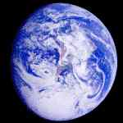
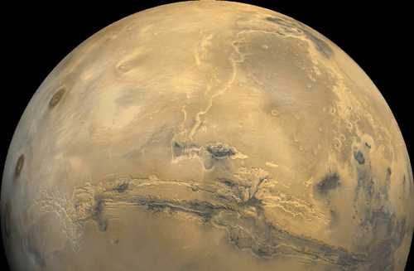
The Grand Tack Model
A. Morbidelli – K. Walsh (Observatoire de la Cote d’Azur, Nice, France)
S. Raymond (Observatoire de Bordeaux, Floirac, France)
D. O’Brien (PSI, Tucson, Az, USA)
Mandell (Goddard SFC, Greenbelt, Md, USA)

Slide 2
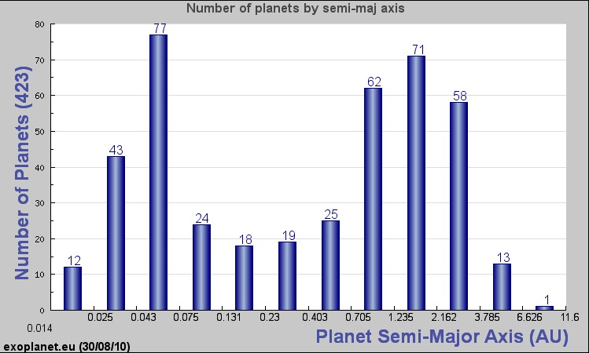
Extra-solar giant planets very often have small orbital semi-major axes
Planet migration is the easiest explanation of this observation

Slide 3
giant planets migration in gas disks
Type II migration: Lin & Papaloizou, 1986
Type II migration explains the origin of the Hot Jupiters (Lin et al., Nature, 1996)
But we don’t have a Hot Jupiter here, so what happened?

Slide 4
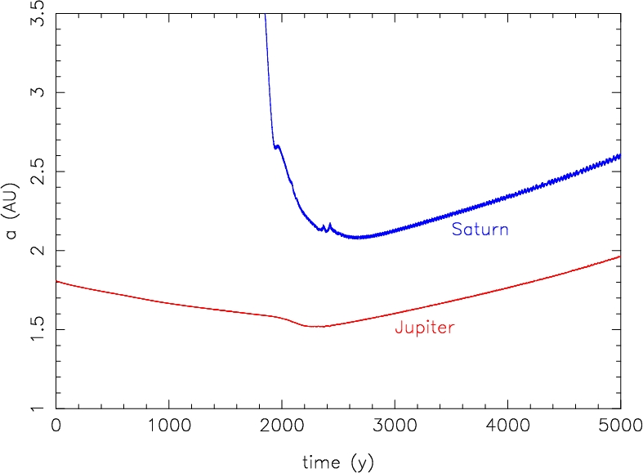
Why did Jupiter not migrate all the way into the inner Solar System?
The “Grand Tack scenario”
Simulation from A. Crida
(arbitrary units)
It tacks!
Mechanism first pointed out by Masset and Snellgrove, 2001

Slide 5
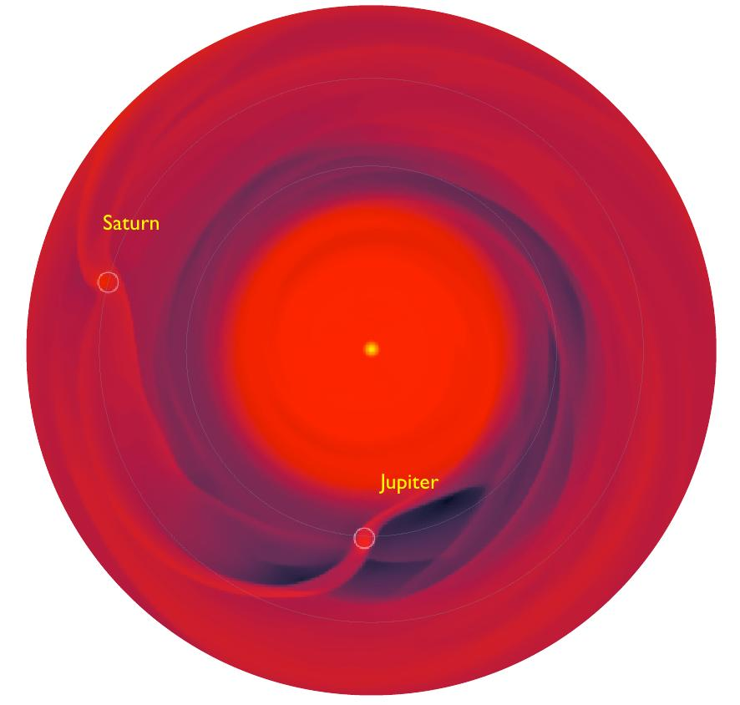

Slide 6
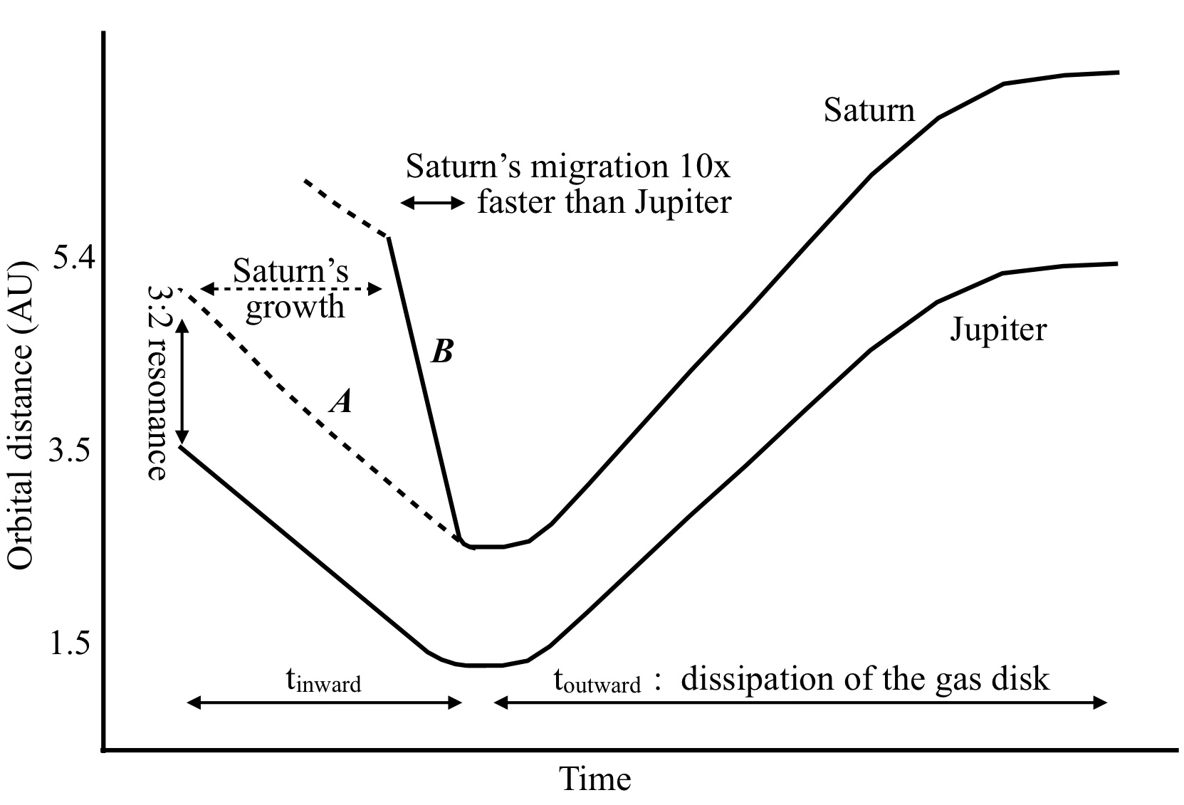
Evolutions of Jupiter and Saturn:
Scenarios consistent with hydro-dynamical simulations

Slide 7
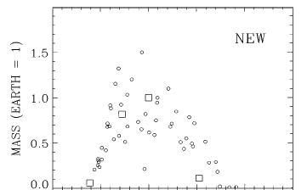
Simulations of Terrestrial Planets formation, usually start from a disk of planetesimals and planetary embryos, ranging from the Sun to Jupiter’s current orbit….
..and Mars turns out systematically too big!

Slide 8
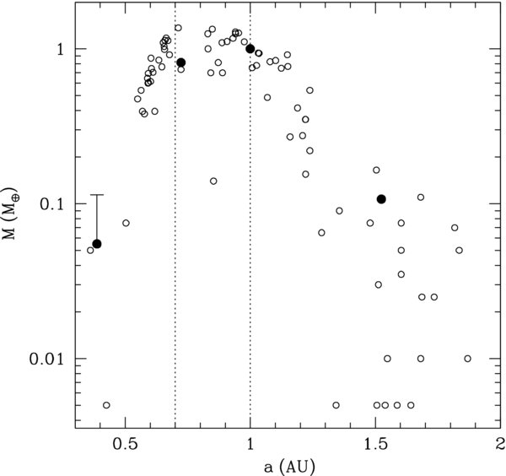
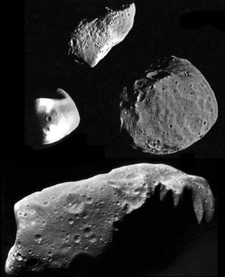
Hansen, 2009
Ida & Lin, 2008
Outer edge @ 1.0 AU
?
Inner edge @ 0.7 AU

Slide 9
Evolutions of Jupiter and Saturn:
Scenarios consistent with hydro-dynamical simulations

Slide 10
Walsh et al., 2011

Slide 11
Walsh et al., 2011

Slide 12
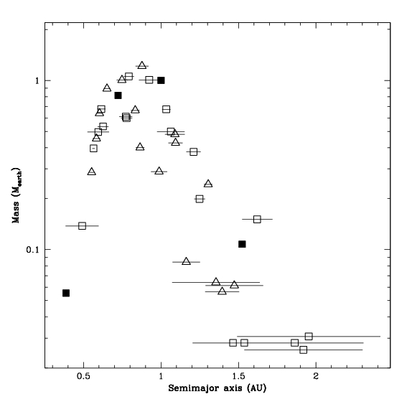
As in Hansen (2009), the statistical mass distribution of the synthetic planets produced in our simulations reproduces the observed distribution very well.

Slide 13
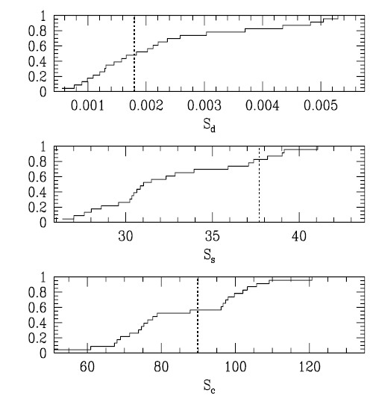
final orbital architecture
Hansen, 2009

Slide 14
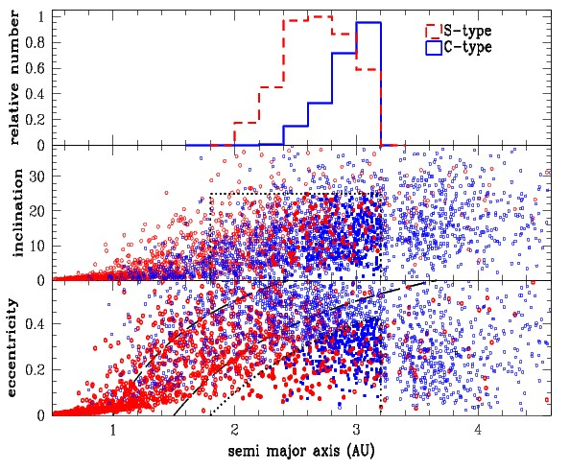
water delivery

Slide 15
water delivery

Slide 16
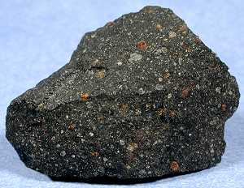
Water delivery
Planets > 0.5 Earth mass accrete median value of ~2.5% Earth mass of C-type material. ~3-4% not rare.
Assuming 10% water by mass (consistent with carbonaceous chondrites), this gives ~2.5x10⁻³ (up to 4x10⁻³) Earth masses of water
Earth has ~5-20x10⁻⁴ Earth masses of water‏
Notes:
16

Slide 17
If the amount of accreted water and its chondritic origin seem to be consistent with geochemical constraints a more in depth study is needed to chel whether the GT model is consistent with the overall chemistry of the Earth and of the other terrestrial planets.
This is the goal of the collaboration with D. Rubi within the ACCRETE project.

Slide 18
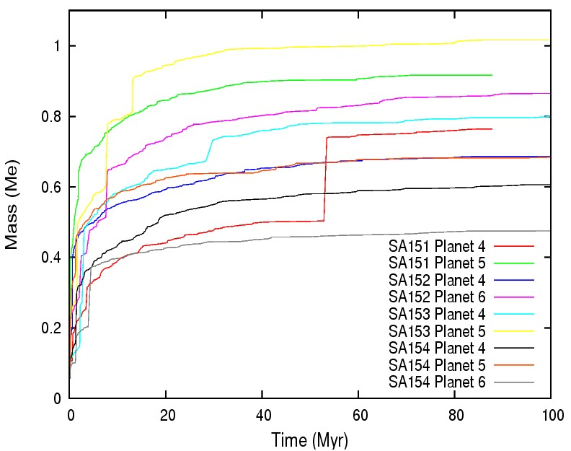
PROBLEMS
a) Our terrestrial planets are generally too small. Earth mass planets are rare. More typical are planets with 0.6-0.8 Earth masses b) as almost the entire mass is conserved and we start with ~ 2 earth mass of material, (a) is related to the fact that we often end with > 2 massive planets c) Mars is in general too small! In most cases it is just an original embryo which accreted a few planetesimals. In a few cases, there is a Mars with the correct mass, but it takes too long to accrete, compared to Dauphas chronological constraint d) Earth formation is fast and late giant impacts are rare e) the late veneer is too large, even in most cases with a late giant impact

Slide 19
Need to broaden the study of the Grand Tack model
Our plan in three steps:
Explore the stochastic variability of the results within the same set up (properties of the initial disk and of the migration of the planets) beyond what was done in Walsh et al. (2011) – See O’Brien’s talk.
Explore a variety of initial set-ups (mostly disk properties, the exploration of the dependence of the results on migration properties was done fairly exhaustively in Walsh et al.)
Remove simulation oversimplifications (perfect sticking, no interaction among planetsimals, no collisional grinding).

Slide 20
More on step 2
We are currently exploring a matrix of initial conditions
M_{Emb} (M_{Mars})
Hansen simulation had only small embryos (no planetesimals). He got better results in terms of Earth and Mars masses, but not for hwat concerns the Earth accretion timescale and late giant impacts.
With larger embryo masses, we should form a Mars-mass planet faster
Larger M^{tot}_{Emb}/M^{tot}_{p} should reduce dynamical friction, allow the formation of fewer but more massive planets, protract the phase of mutual collisions. But would the final orbits still be OK?
0.80
10sims
10sims
0.50
Walsh
10sims
10sims
0.25
Walsh
10sims
10sims
0.05
Hansen
1
2
4
M^{tot}_{Emb}/M^{tot}_{p}

Slide 21
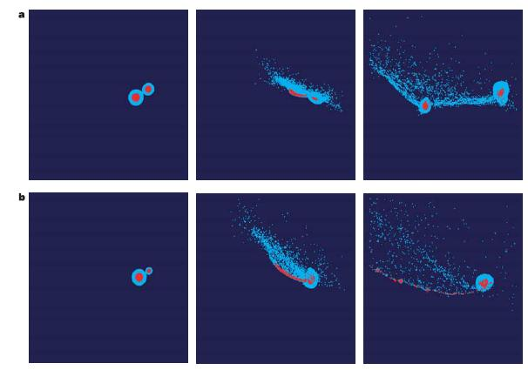
More on step 3
Imperfect accretion (hit and run collisions) may explain why the bulk iron/silicate ratio increases moving from asteroids to Mercury
Collisional grinding of planetesimals may reduce the planetesimal population faster than the sole dynamics would do, helping to solve the Late Veneer problem. But would this prevent late dynamical friction and leave the planets on orbits too excited?
Both imperfect collisions and planetesimal grinding are difficult to model in the N-body simulations. This step will require a lot of work for producing a new code.

