Slide 1


Chemical and isotopic consequences of lossy accretion: Preliminary results
Francis Nimmo & Tina Dwyer
(U. C. Santa Cruz)
John Chambers
(DTM)

Slide 2
Outline
Accretion model incorporating fragmentation
Preliminary isotopic and bulk chemical results

Slide 3
Accretion Model
(Chambers, submitted)
16 runs
Low resolution (154 initial objects)
Half mass in embryos, half in planetesimals
Same initial conditions as Chambers (2001)
Jupiter and Saturn on present-day orbits
Accounts for hit-and-run collisions and fragmentation (typically ignored previously)

Slide 4
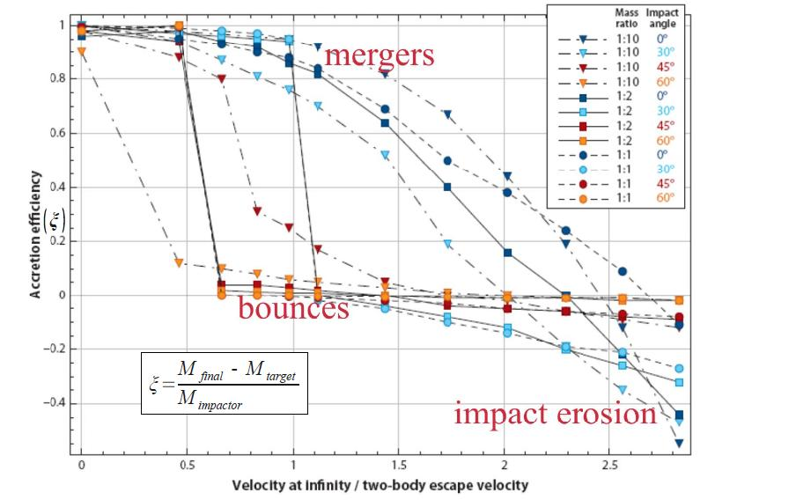
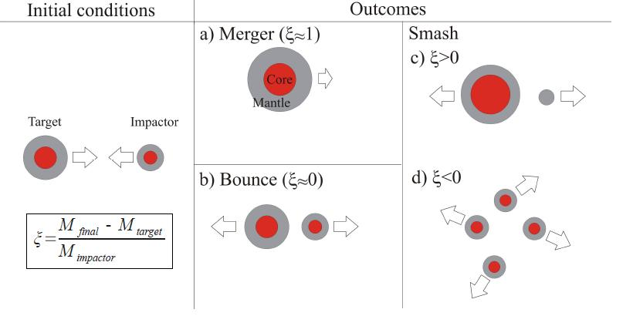
Inefficient Accretion
Increasing
Erosion
Asphaug (2009)

Slide 5
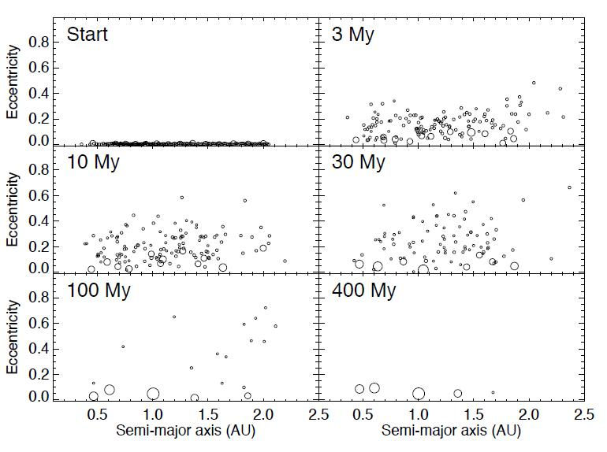

Slide 6
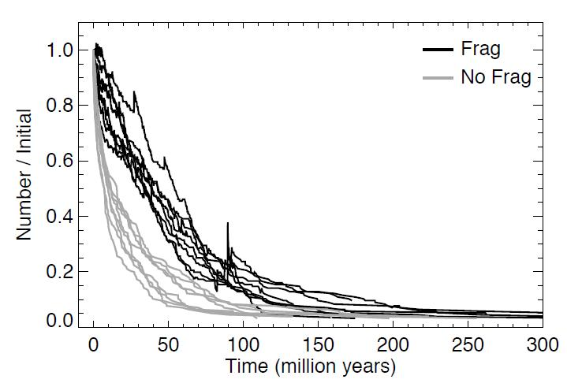
Number of bodies

Slide 7
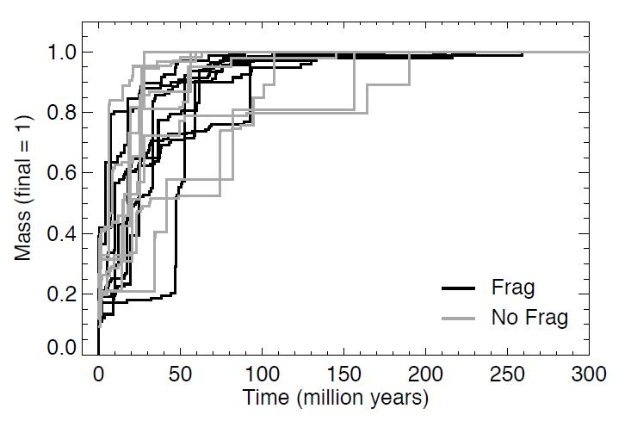
Mass Evolution

Slide 8
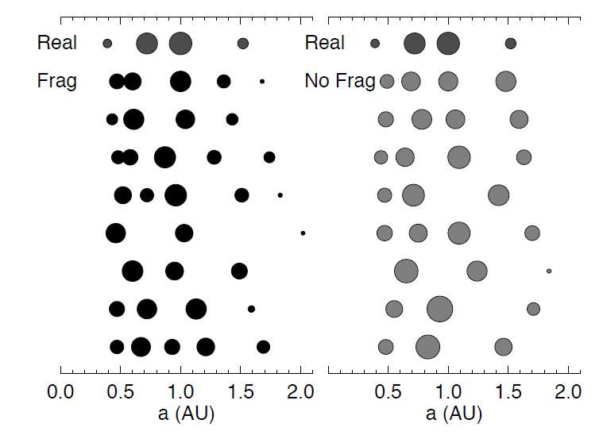
Final Planets

Slide 9
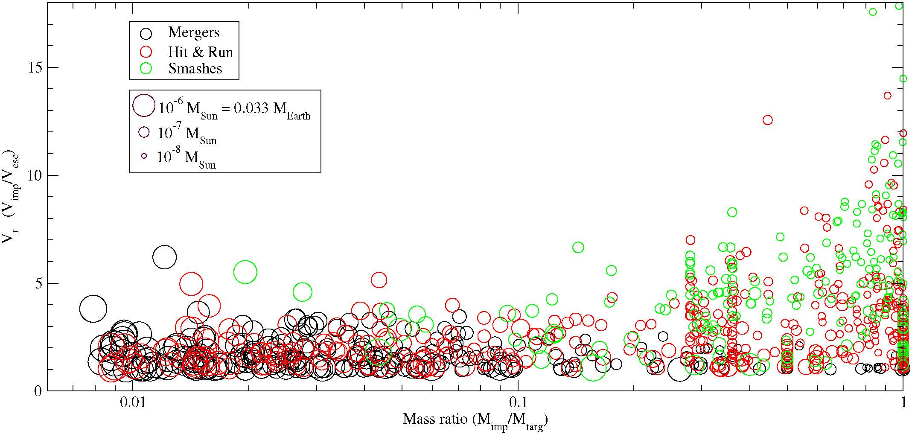
Collision types

Slide 10
Dynamical Results
Roughly half the collisions are hit-and-run
Timescale to reach half final mass comparable to perfect merger cases
Timescale to complete accretion slightly longer than in perfect merger case (cf. Kokubo and Genda 2010)
Final planets slightly less massive, slightly more of them (on average)
Eccentricities slightly lower (on average)
Radial mixing relatively efficient

Slide 11
Collisions and bulk chemistry
Post-processing step
Escaping mass in this order: projectile mantle, target mantle, projectile core, target core
Rare outcomes include “Mercury analogue” mantle stripping events

Slide 12
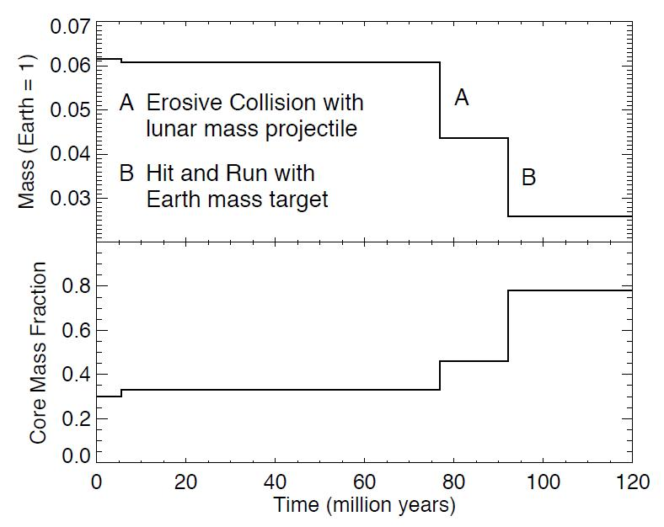
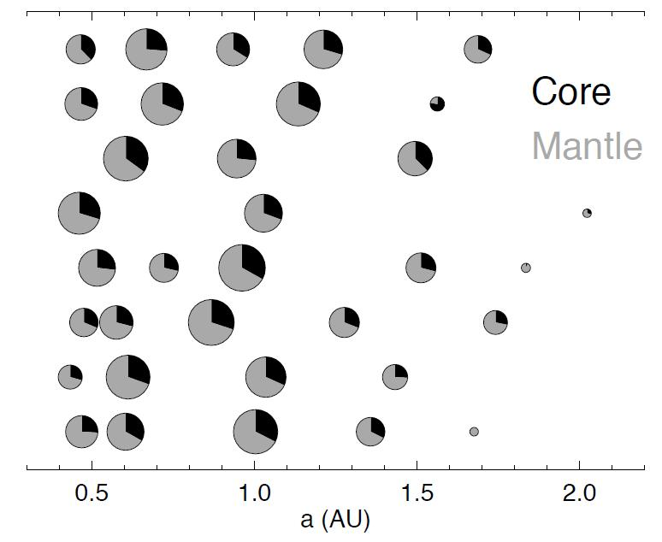

Slide 13
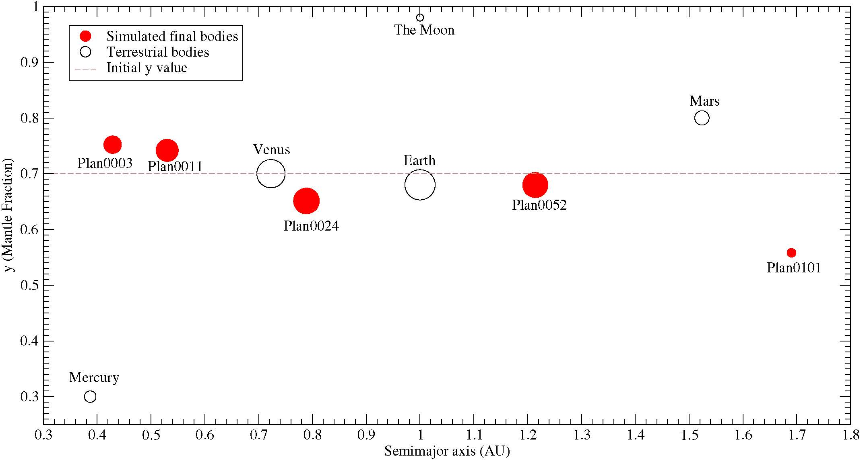
Bulk chemistry outcomes

Slide 14
Hf-W system
¹⁸²Hf decays to ¹⁸²W, half-life 9 Myrs (comparable to accretion timescale)
Hf stays in silicates, W goes into core, so observations time core formation (related to accretion process)
Late core formation – no excess ¹⁸²W
¹⁸²Hf (rock-loving)
¹⁸²W (iron-loving)
Core forms
Early core formation – excess ¹⁸²W in mantle
Other systems?
(Pd-Ag)
Core forms
Differentiated
mantle
Undiff. planet

Slide 15
Hf-W (continued)
Degree of re-equilibration (k) unknown
Time-integrated partition coefficient is known (but may have varied considerably)
Partition coefficient varies between planets
We take both to be constant:
  k=0.3
  f ^{Hf/W}=13

Slide 16
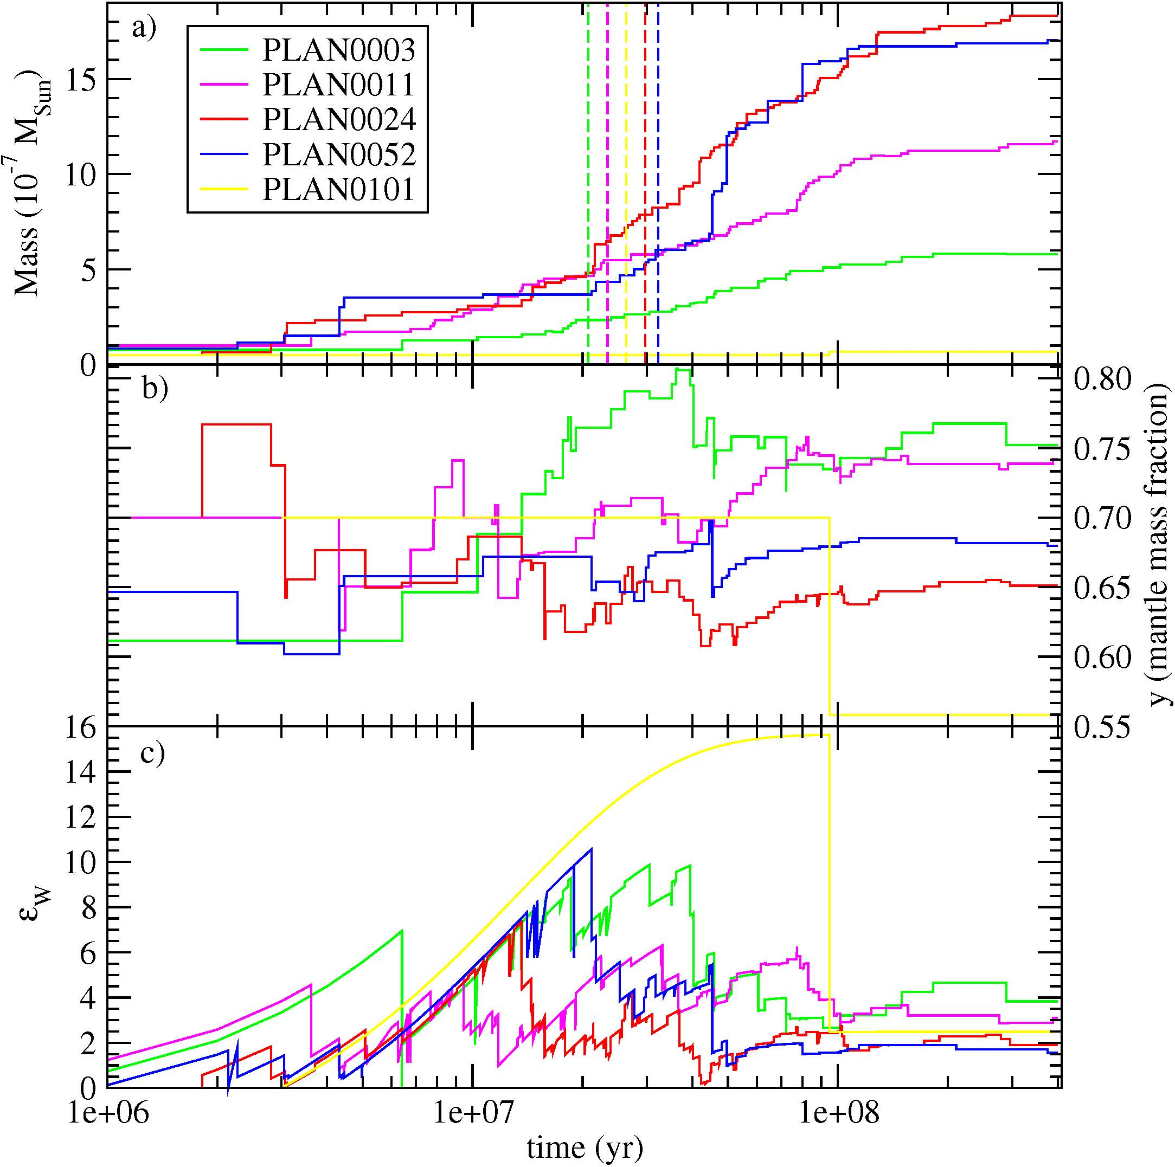
“Single-stage” core formation times

Slide 17
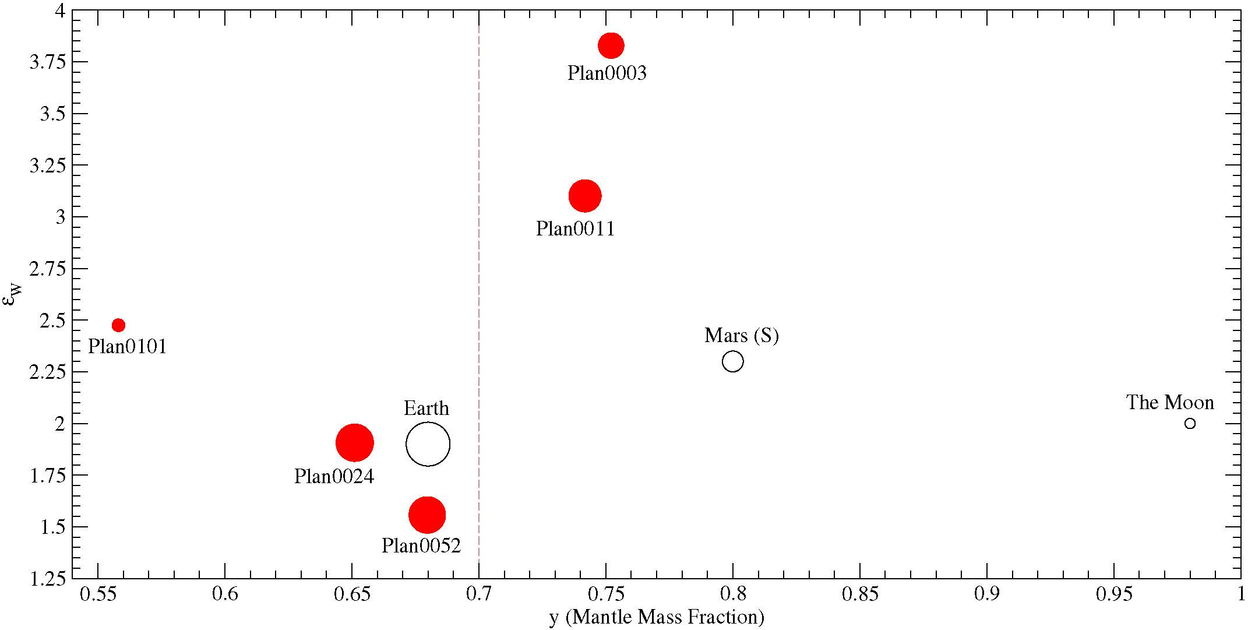
Isotopic outcomes
Large scatter in ε_{W}, even without taking variations in f ^{Hf/W} into account

Slide 18
Future Work
Explore effect of varying k
Better model for how f ^{Hf/W} varies with time/mass/semi-major axis
Can do similar calculations for Pd/Ag system (sensitive to volatility trends)

Slide 19
Summary
Fragmentation has minor (but non-negligible) effects on overall accretion history
Effects on bulk and isotopic evolution are more pronounced (e.g. Mercury analogues)
Fragmentation is a good for helping to explain the observed diversity of the terrestrial planets

Slide 21
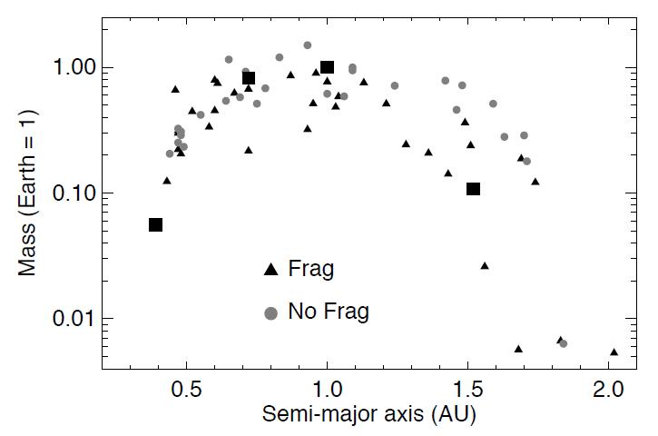

Slide 22
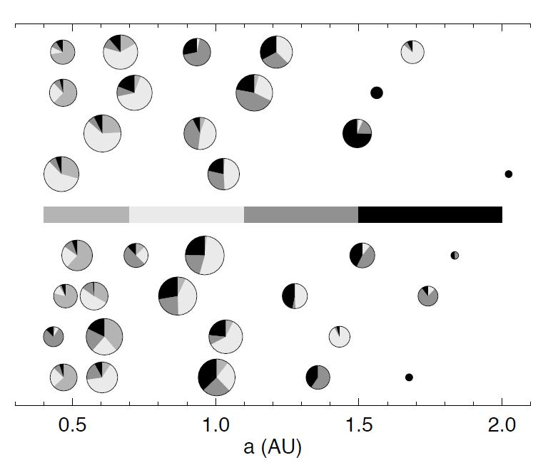

Slide 23
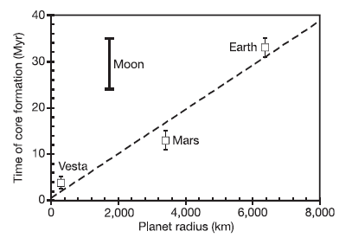
Core formation chronometry
Hf-W isotopic system
Kleine et al. (2002)
Rock
Rock+
Metal
Metal

Slide 24
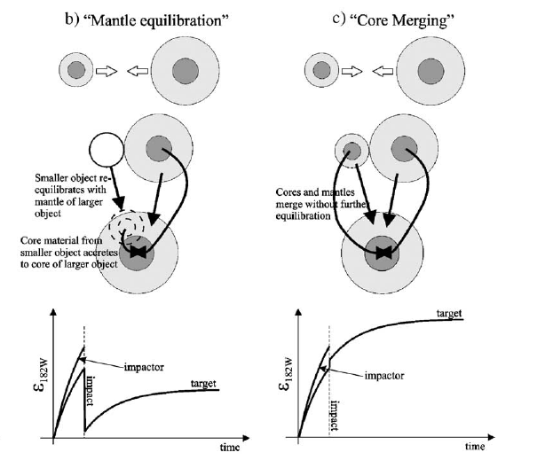
What happens during a collision?
Mantle re-equilibration
Core merging (no equilibration)
Nimmo &
Agnor (2006)
Equilibration reduces the tungsten anomaly

Slide 25
Equilibration?
Re-equilibration happens at cm-scale
Large impacts deliver ~1000 km-scale objects
What happens?
Problem very hard to address numerically
Laboratory experiments? (Olson & co.)
Currently very poorly understood
Silicate mantle
(molten)
~ km/s
Shearing
instability?
Density
instability?
Existing core
Notes:
25

Slide 26
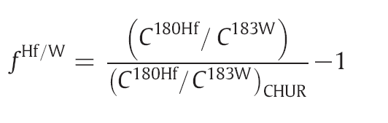
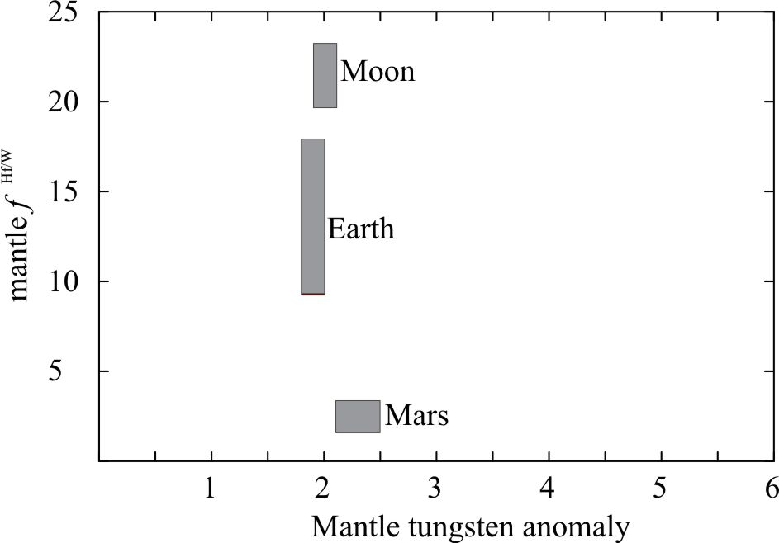
Definitions & Observations
From Kleine et al. 2009
Notes:
26

Slide 27
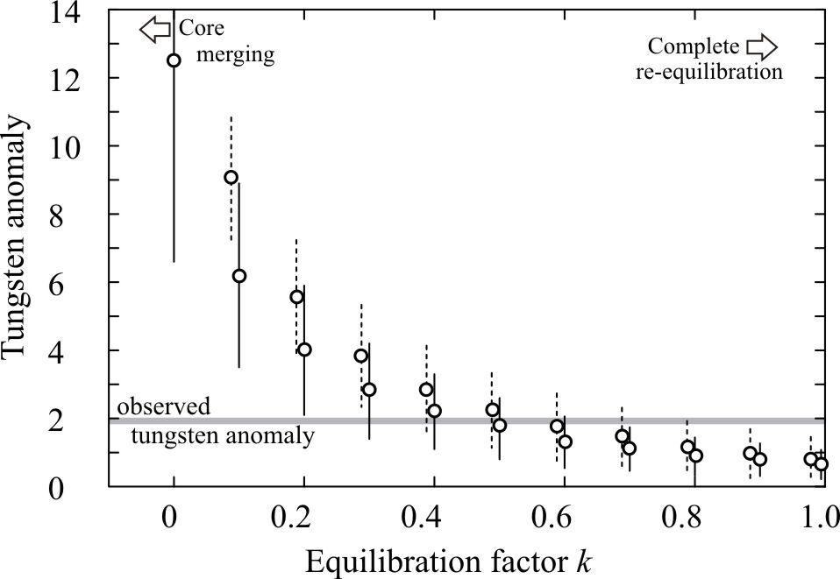
Equilibration factor k
Intermediate k-values match terrestrial constraint

Slide 28
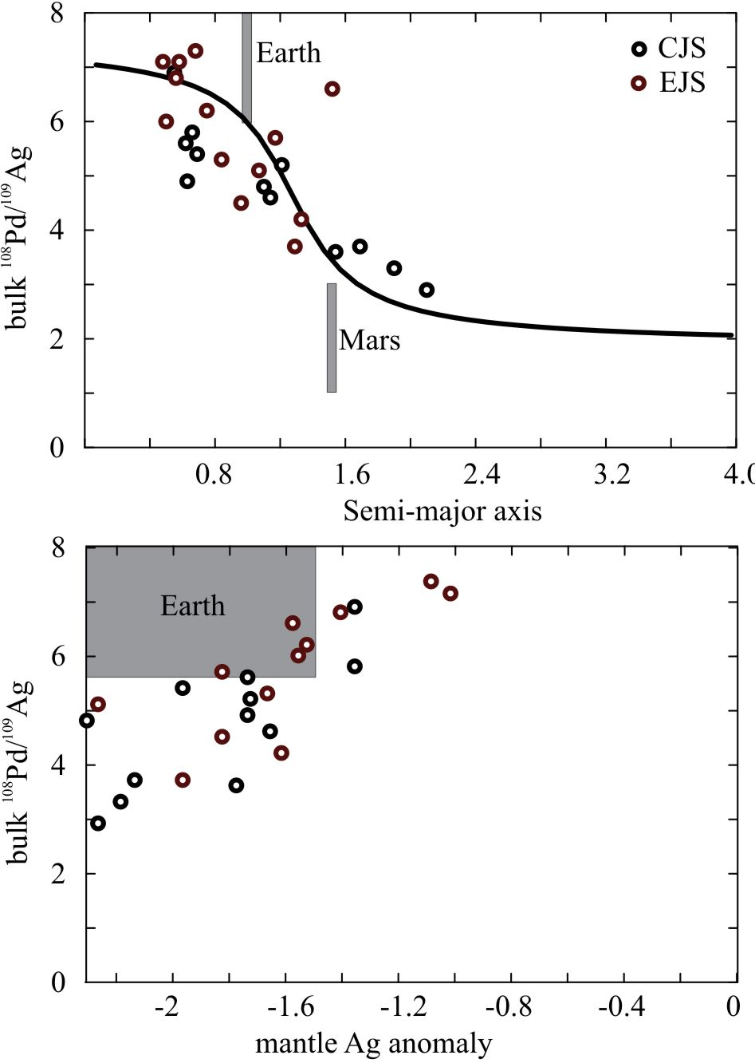
Pd/Ag system
Behaves like Hf/W system
But Ag is volatile – additional complication
Measurements hard to make (Schonbachler et al. 2010)
Results suggest a spatial gradient in Pd/Ag is required (snow line?)
Can satisfy both Hf/W and Pd/Ag for k 0.5
k=0.3

Slide 29
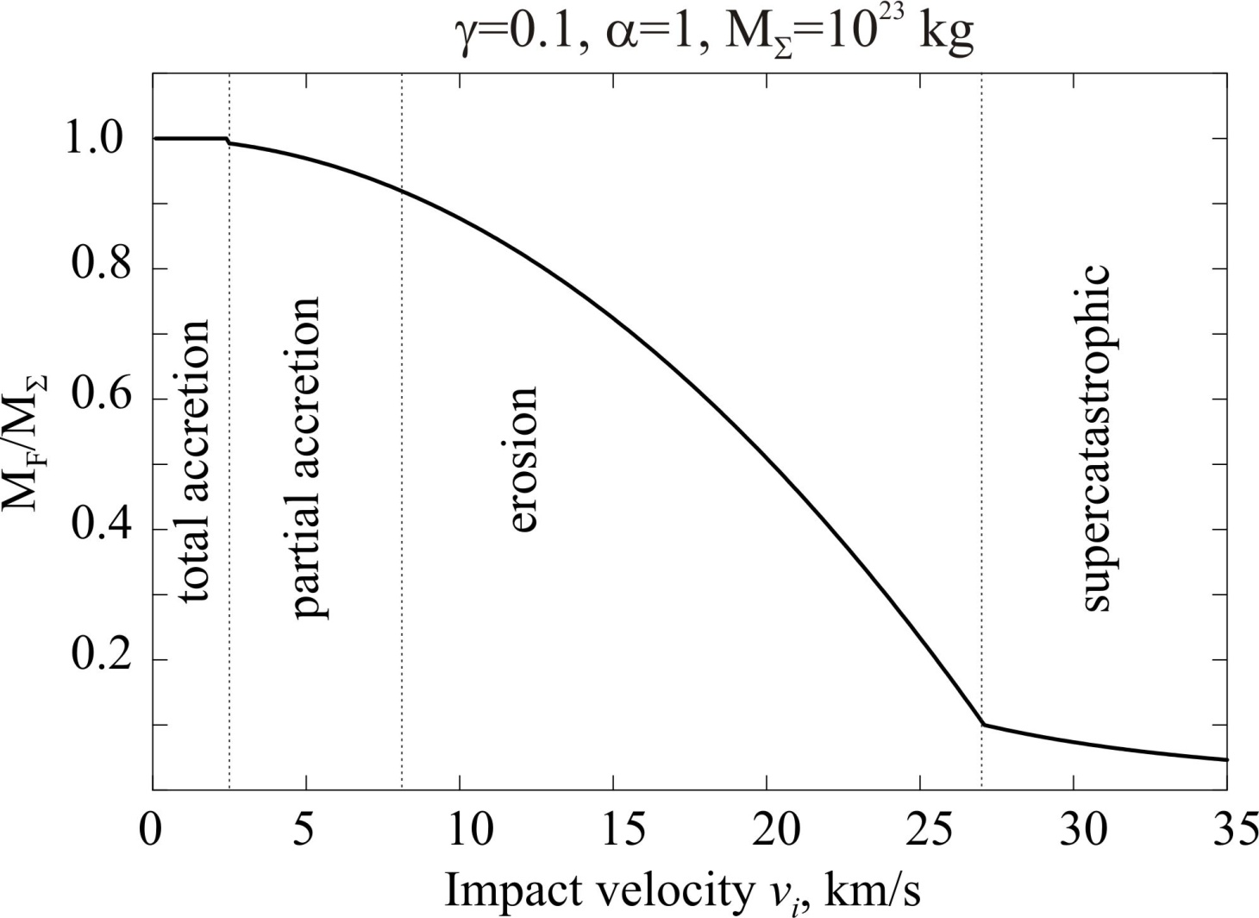
Impact Erosion (cont’d)
Uses formulation of Leinhardt and Stewart (2012)
Not fully self-consistent!

Slide 30
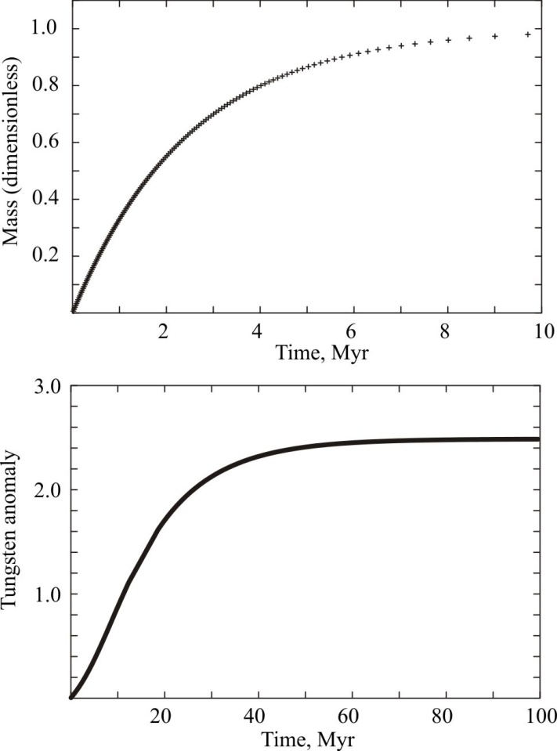
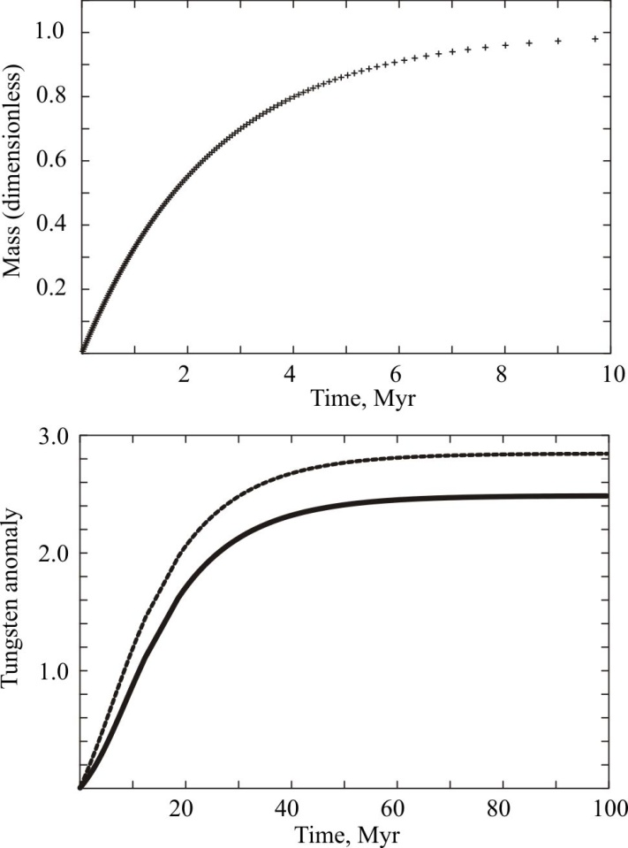
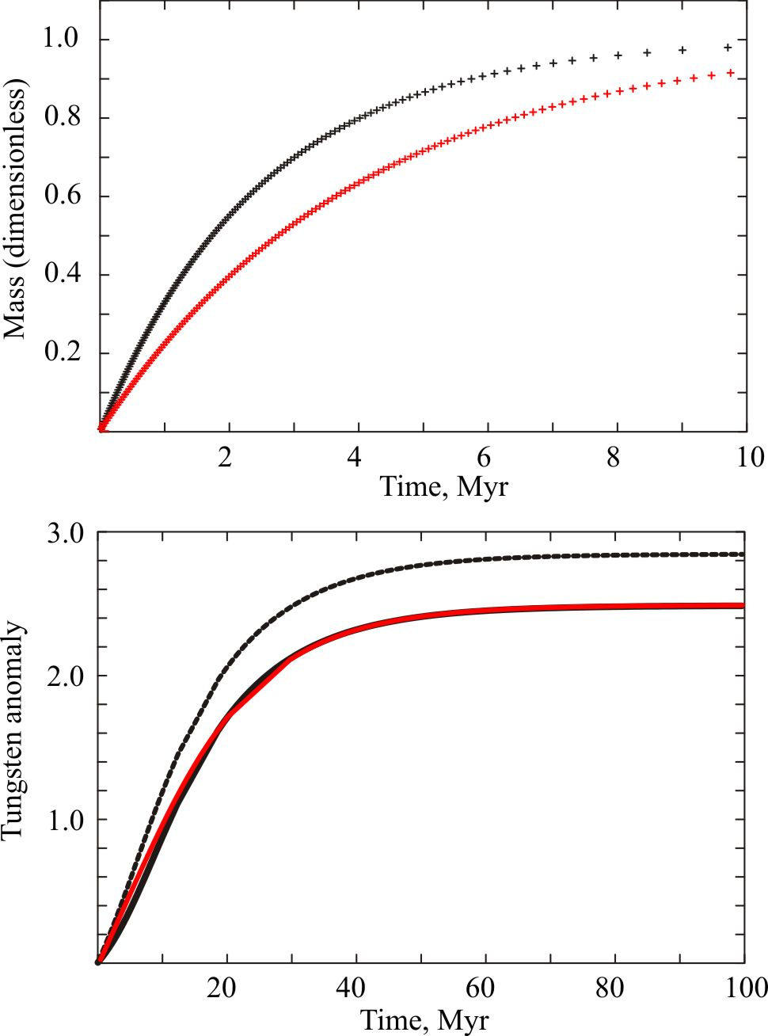
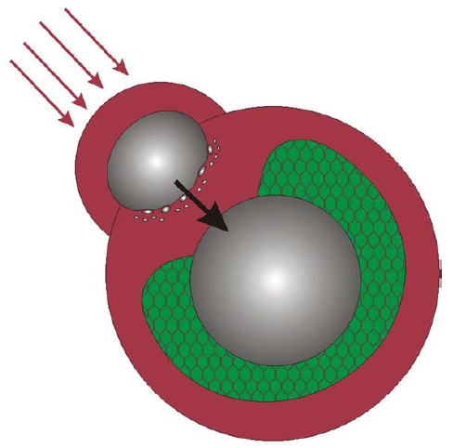
Degree of equilibration (k)
τ=2.5 Myr
τ=4 Myr
core
magma
core
k=0.25
Mars
k=1
k=1
k=0.25
Cf. Dauphas & Pourmand,
Nature 2011
Equilibration (k) and accretion timescale trade off
Rapid formation of Mars is obtained because complete re-equilibration is assumed. Is this reasonable?

Slide 31
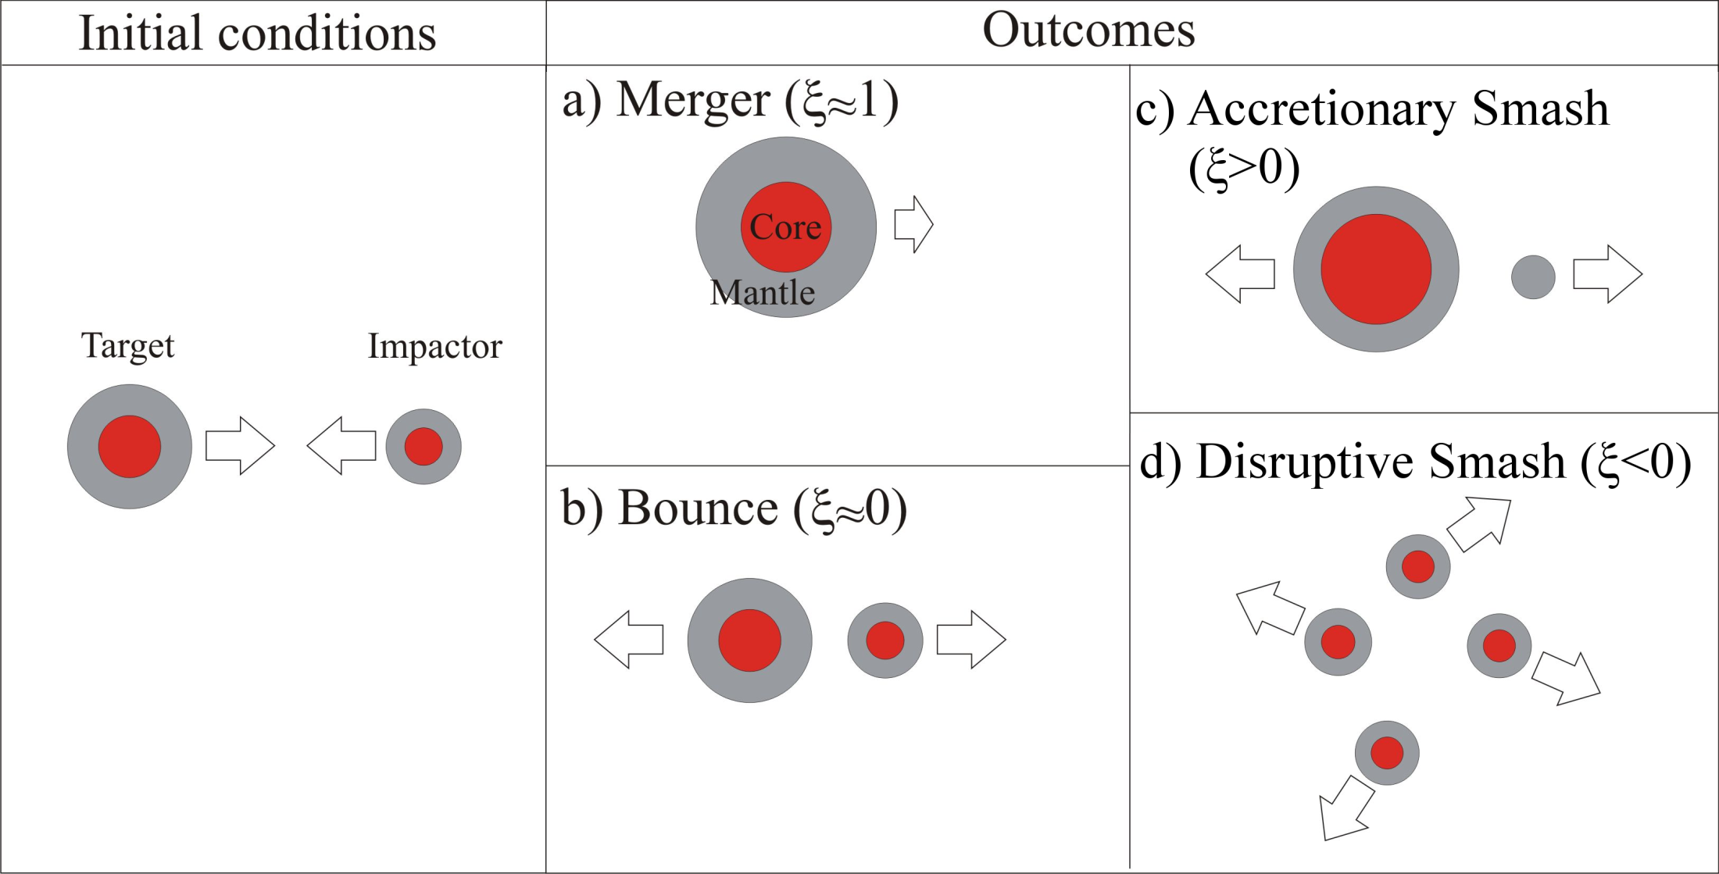
Different Outcomes

Slide 32
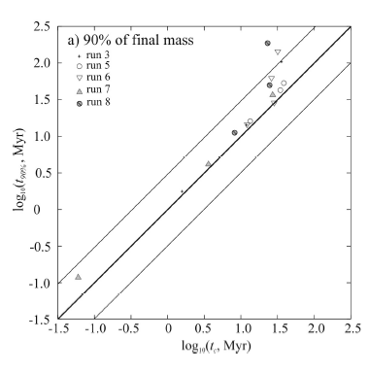
Accretion is stochastic!
Nimmo and Kleine (2007)
N-body simulations can calculate synthetic tungsten anomalies (Nimmo & Agnor 2006)
Synthetic W anomaly gives analytical “two-stage” timescale
Analytical timescale can differ by factor ~3 from “true” model timescale
“True” model time
factor of 3
Analytical expression

Slide 33
“Single-stage” (instantaneous) core formation timescale
Tungsten anomaly increases with more rapid core formation or bigger Hf/W fractionation
Given f ^{Hf/W} and ε_{W} (observed), we can calculate core formation time t_{c} . . . Or vice versa
Instantaneous core formation is an approximation to true process (multiple, stochastic impacts)

