Slide 1
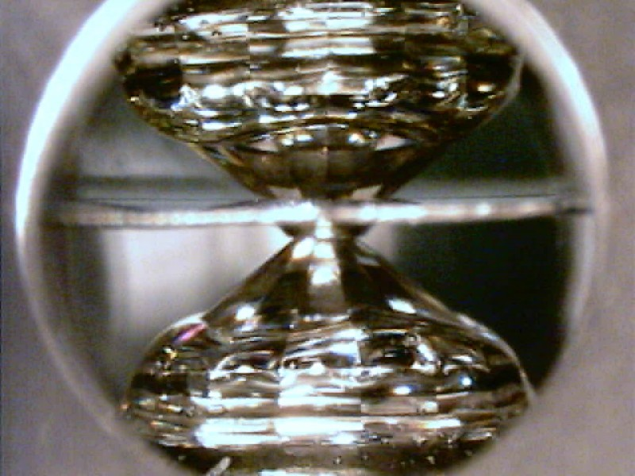
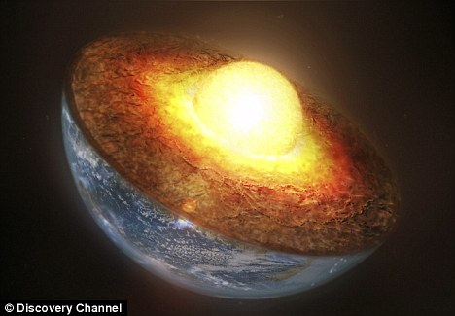
Metal-silicate experiments in the laser-heated diamond anvil cell
Rebecca A. Fischer
University of Chicago
BGI group meeting
31 January 2013

Slide 2
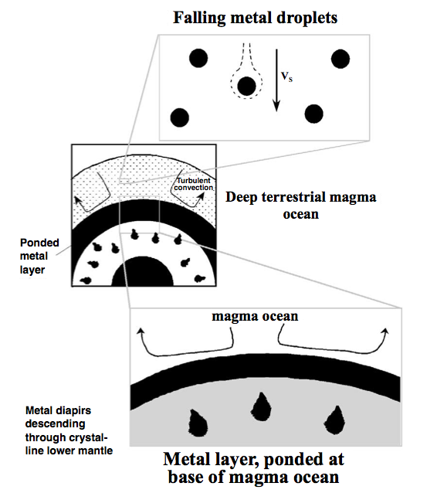
Introduction
Possible picture of core formation:
Rubie et al. (2003)

Slide 3
Introduction
Possible picture of core formation:
What are the chemical reactions between metal and silicate?
Method: High P-T experiments, FIB recovery, TEM chemical analysis
Under what P-T-fO₂ conditions (or range of conditions) did the core last equilibrate with the mantle?
What is the composition of the Earth’s core?
Rubie et al. (2003)

Slide 4
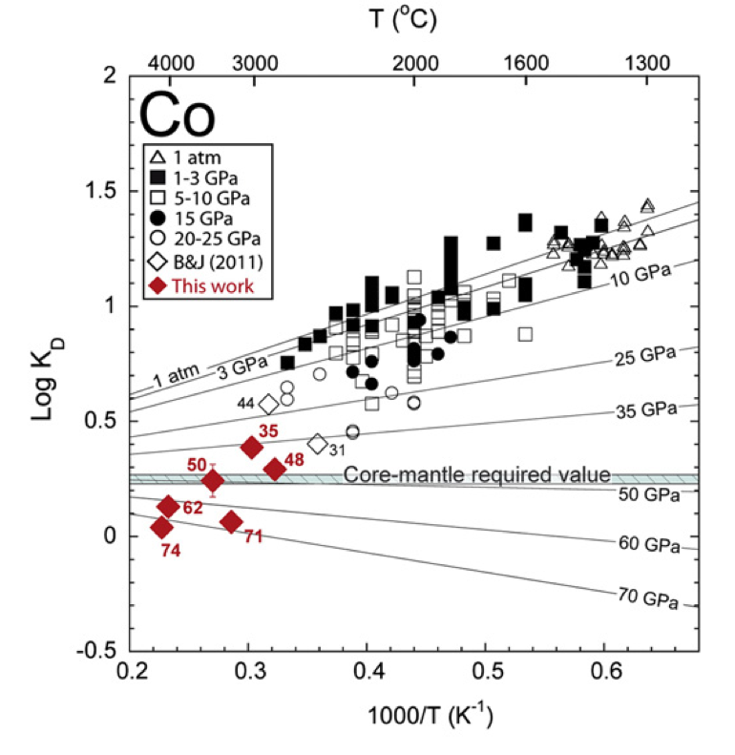
Previous work
Many partitioning experiments at lower pressures, very few at higher pressures
K_{D} = D_{M} / D_{Fe}^{n/2}
= (X_{M,met}/X_{M,sil}) / (X_{Fe,met}/X_{Fe,sil})^{n/2}
Siebert et al. (2012)

Slide 5
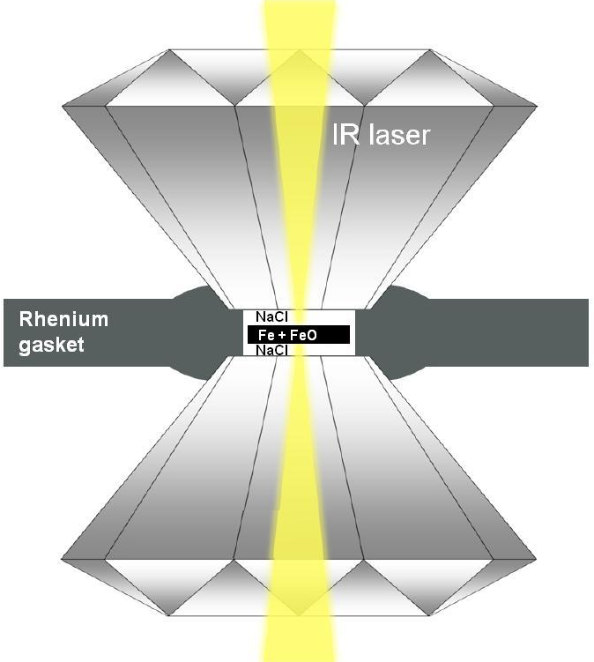
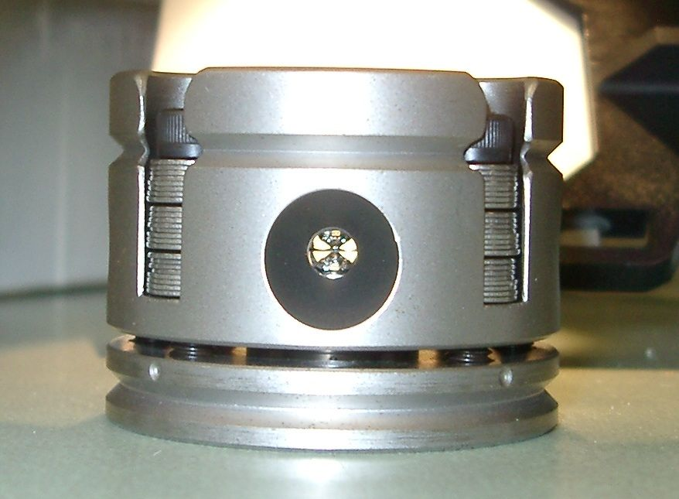
Diamond anvil cell experiments
Pressures of 39-77 GPa and over 4400 K
Metal contains Fe, Ni, Co, V, ± Si
Steel gasket
silicate
Fe-rich alloy

Slide 6
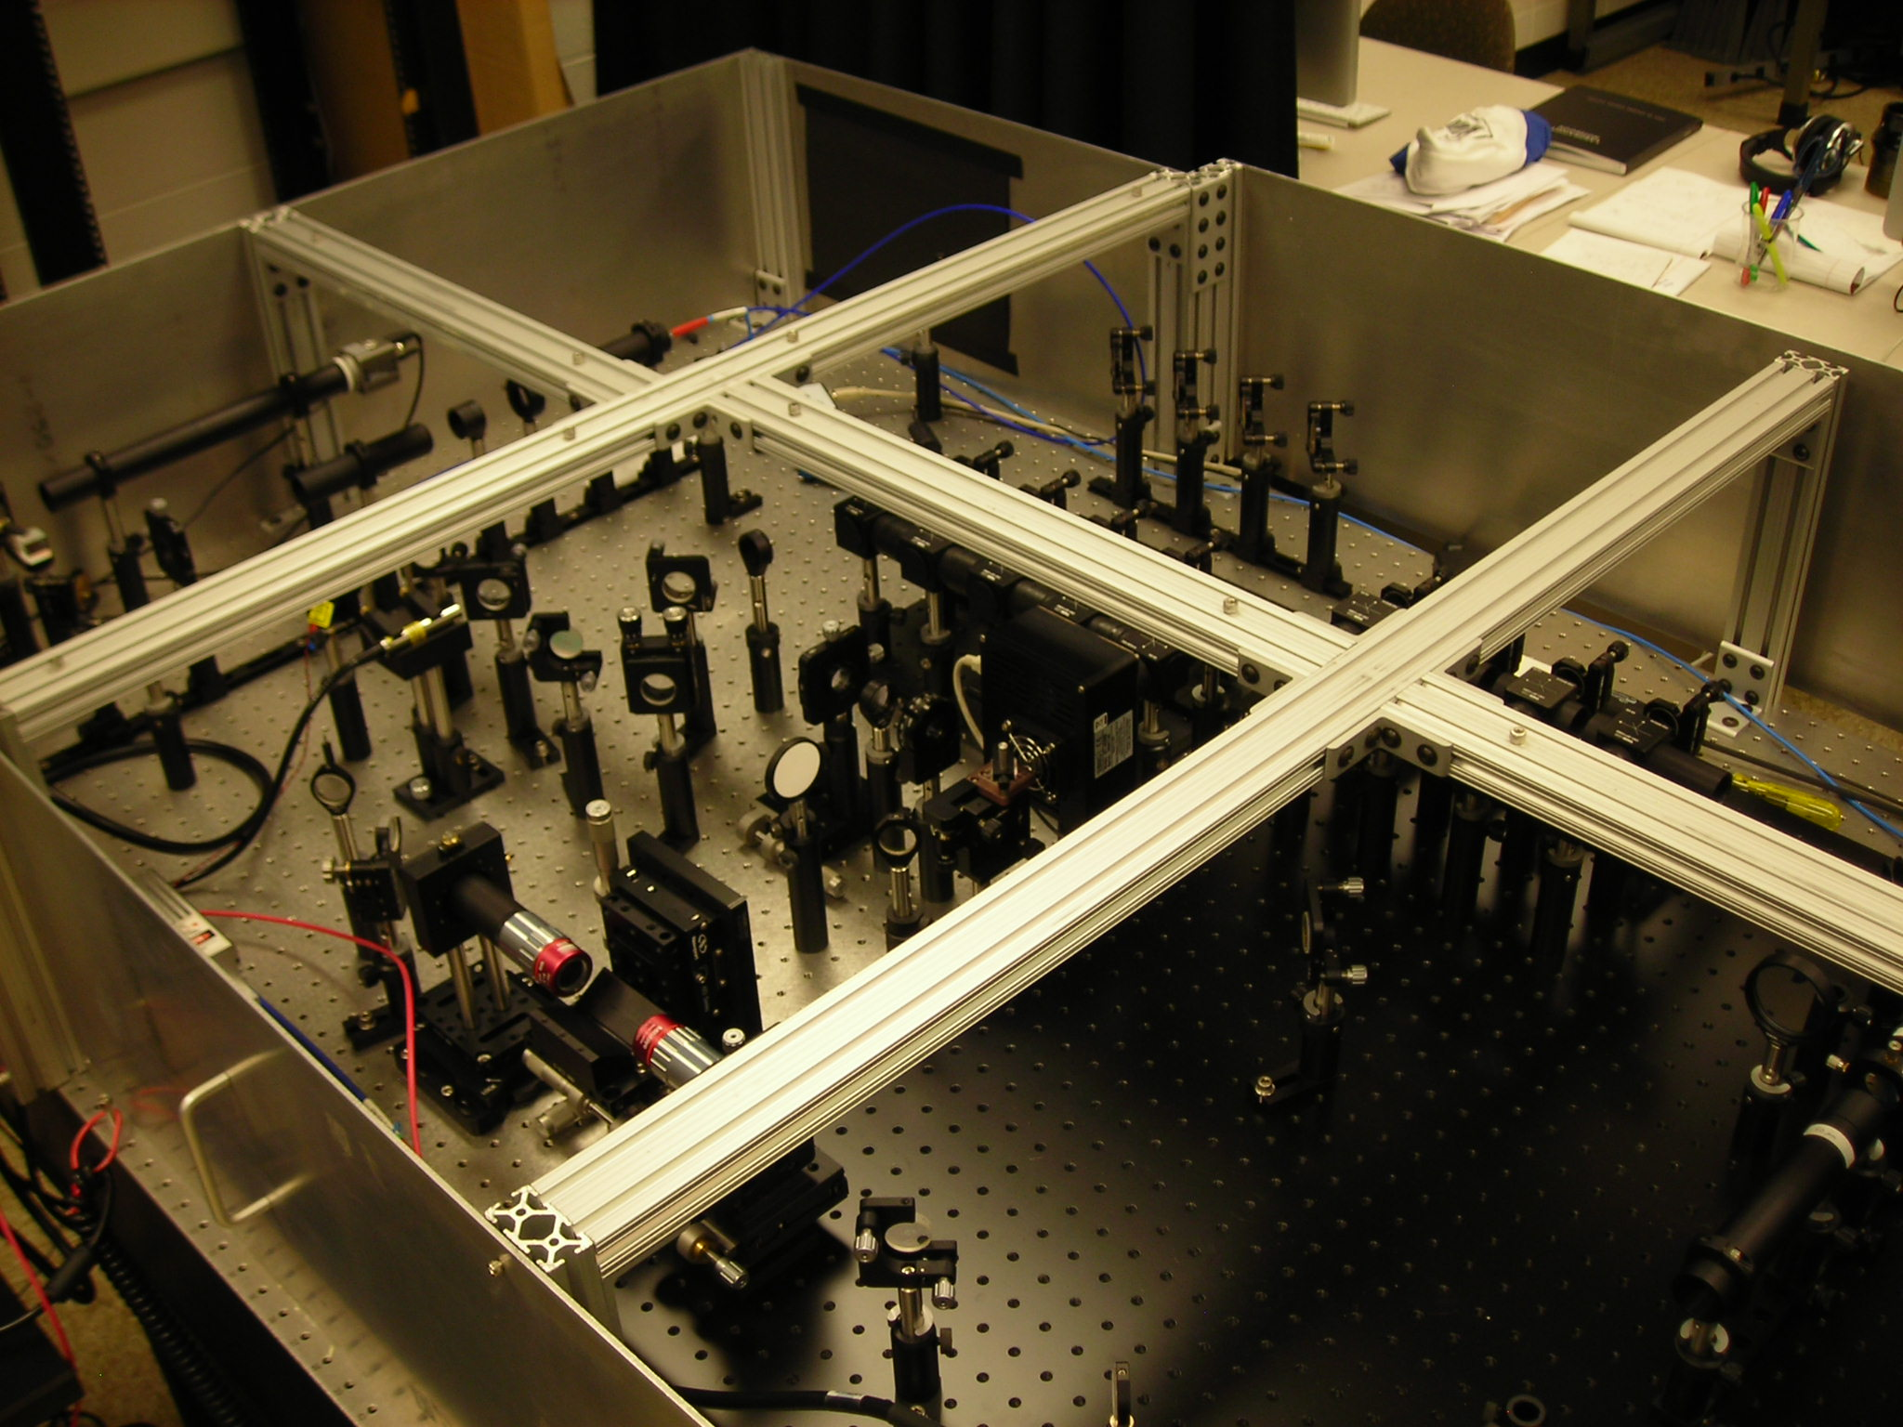
Experiments in our lab
Double-sided laser-heating (λ=1.064 µm)
Spectrometers measure temperatures from cental 5 µm in real time
Camera captures images of laser-heated spot

Slide 7
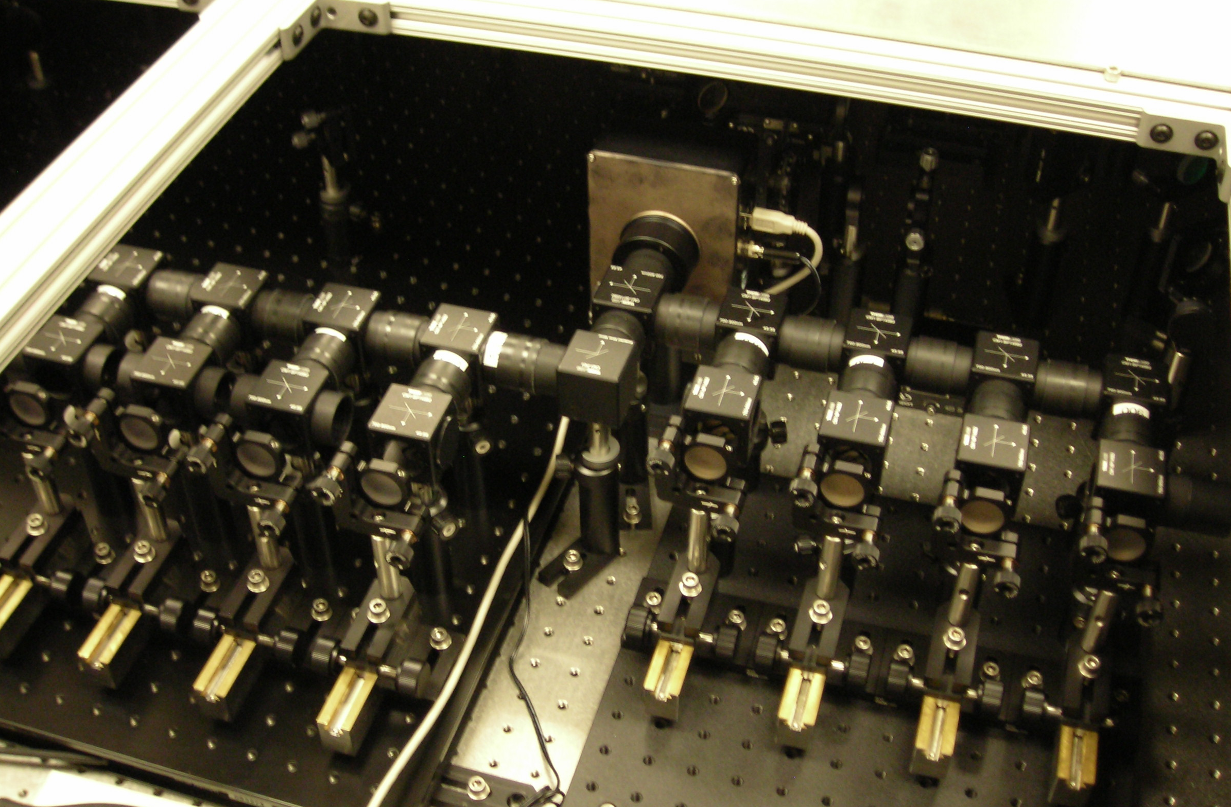
4-color temperature imaging system
670 nm 750 nm 800 nm 850 nm
39 GPa
5 µm

Slide 8
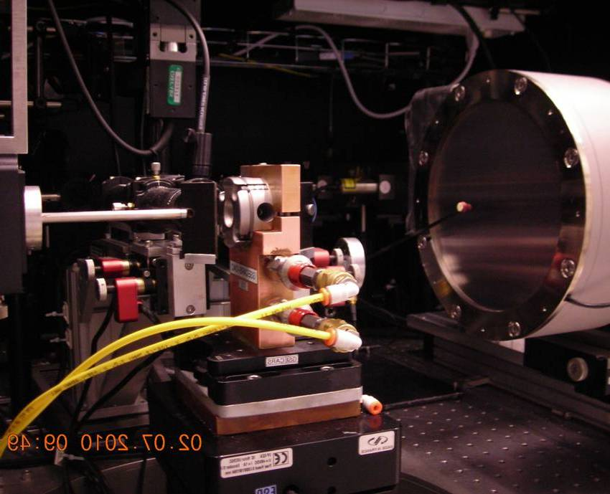
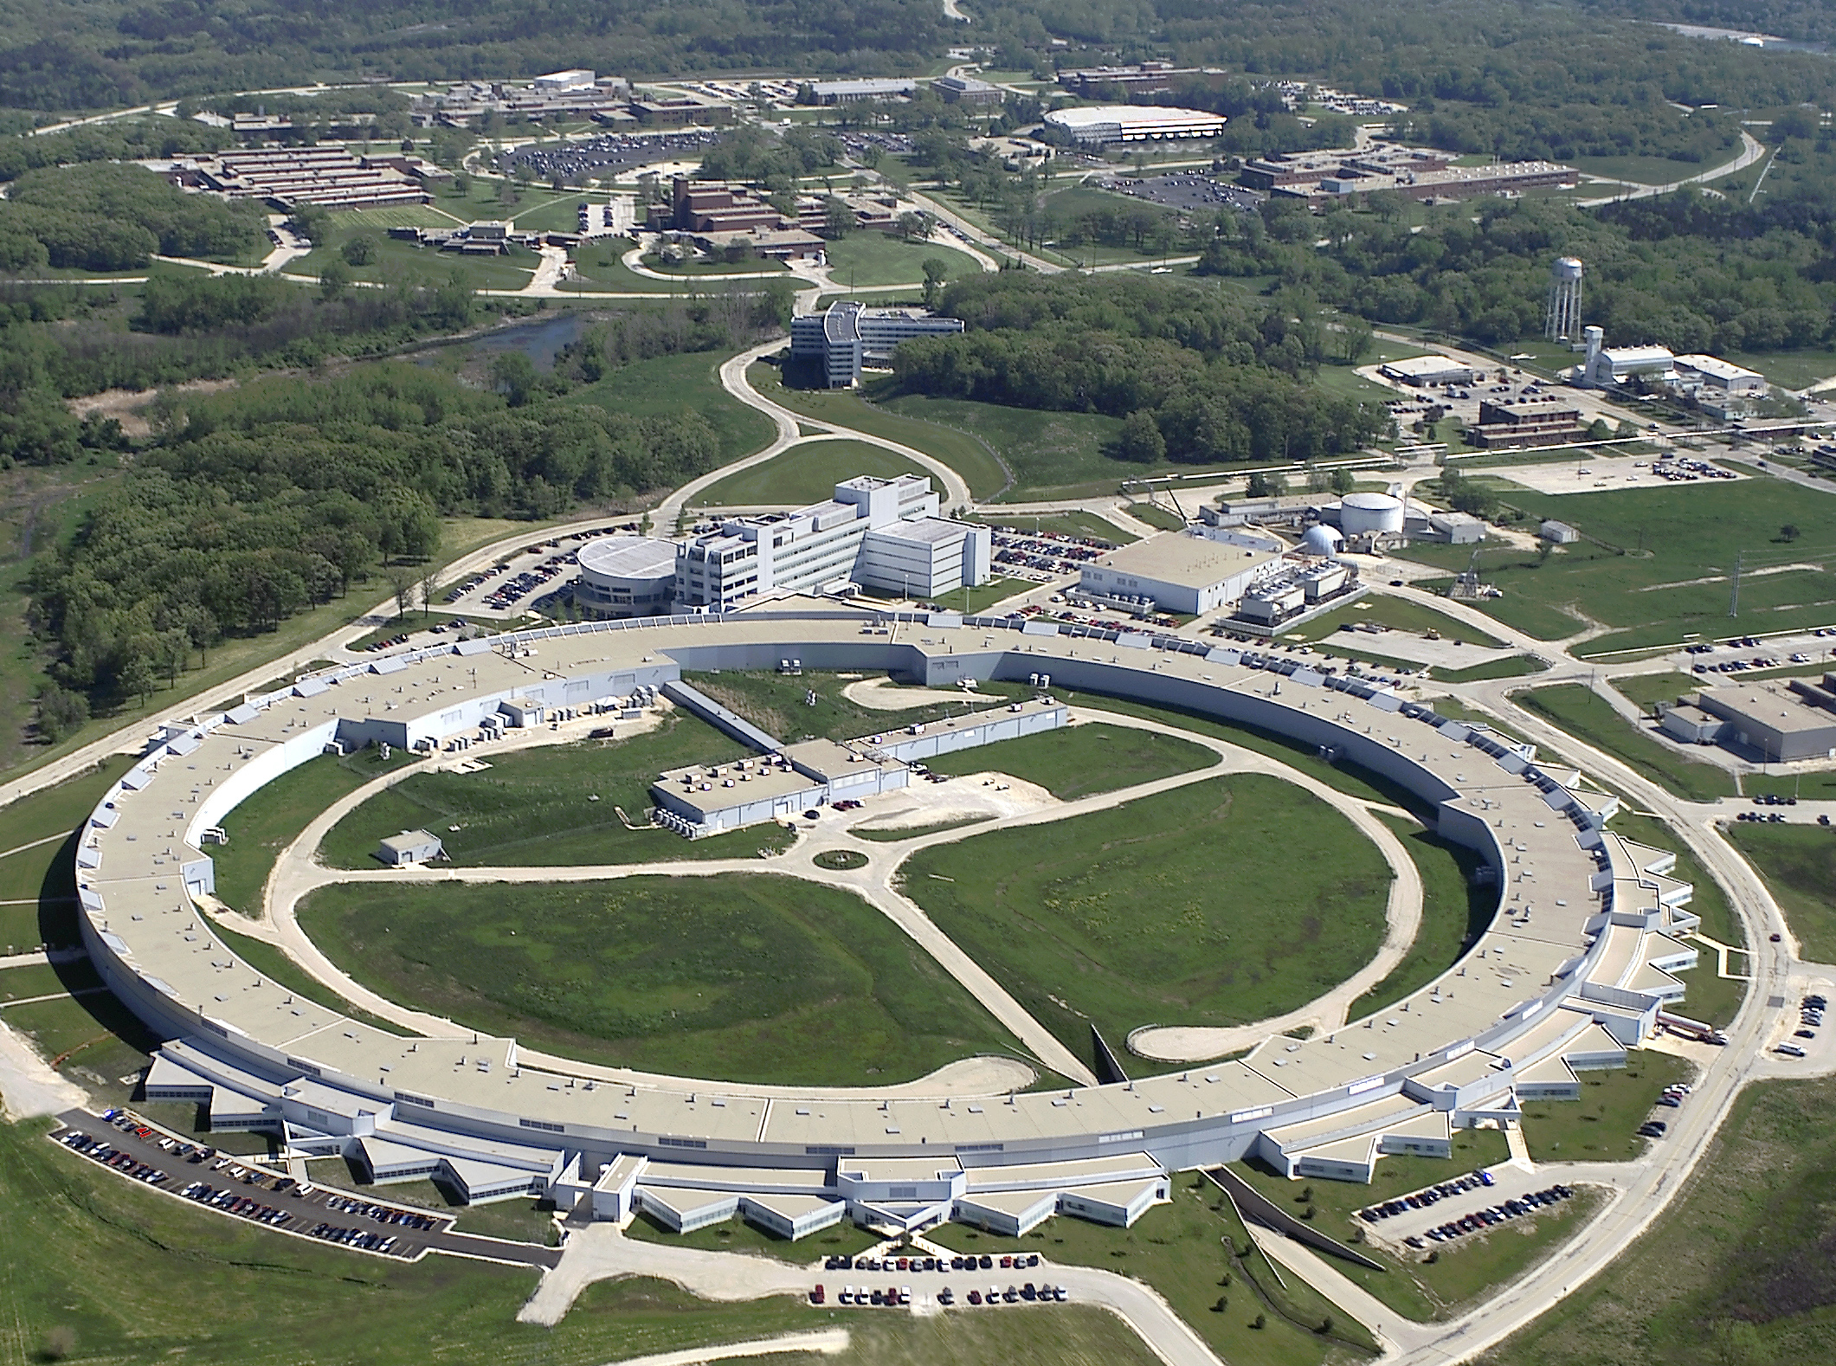
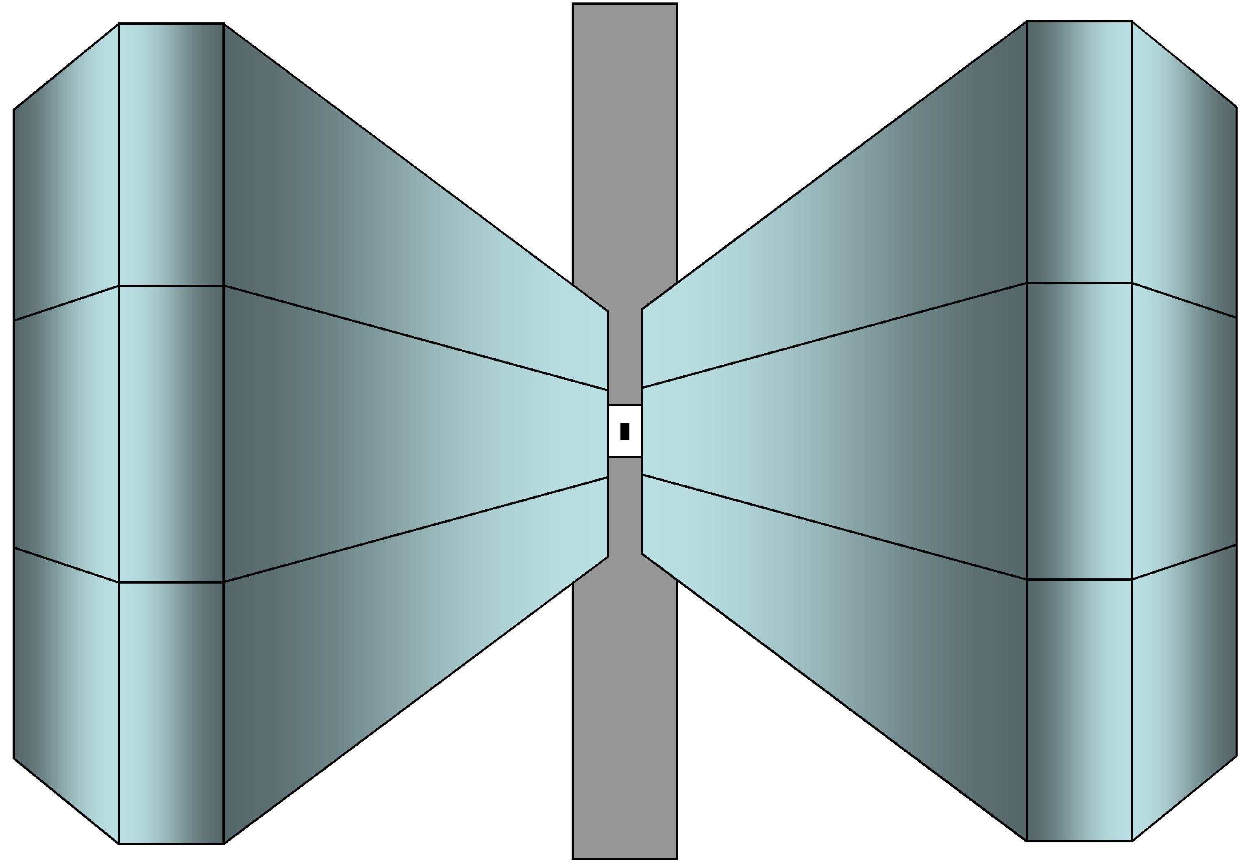
Synchrotron X-ray diffraction experiments
Sector 13-ID-D, APS
X-ray
DAC
laser

Slide 9
X-ray diffraction
Ringwoodite 400
+ hcp Fe 002
Ringwoodite 311
hcp Fe 101
Before heating
65 ± 5 GPa, 300 K
hcp Fe-alloy:
a = 2.361 ± 0.002 Å
c = 3.789 ± 0.004 Å
Ringwoodite:
a = 7.654 ± 0.006 Å
Ringwoodite 333+511
Ringwoodite 731+533 + hcp Fe 201
Ringwoodite 440
Ringwoodite 220
hcp Fe 100
Ringwoodite 111
Ringwoodite 422
hcp Fe 110
Ringwoodite 200
Ringwoodite 800
Ringwoodite 444
hcp Fe 200

Slide 10
X-ray diffraction
At high temperature
72 ± 6 GPa, 3120 ± 160 K
hcp Fe-alloy:
a = 2.390 ± 0.004 Å
c = 3.856 ± 0.006 Å
fcc Fe-alloy:
a = 3.393 ± 0.004 Å
Oxide (ferropericlase):
a = 3.979 ± 0.001 Å
Silicate perovskite:
a = 4.577 ± 0.003 Å
c = 4.746 ± 0.003 Å
c = 6.595 ± 0.005 Å
oxide 200
pv 112
hcp Fe 110 + fcc Fe 220 + oxide 311
fcc Fe 111
pv 220
hcp Fe 002
pv 022
oxide 111 + pv 200
pv 024
pv 202
pv 131
pv 110
hcp Fe 102 + oxide 220
pv 204
pv 123
hcp Fe 100
pv 132
pv 020
pv 114
hcp Fe 101 + pv 113
pv 224
fcc Fe 200
pv 130
pv 111
pv 310
pv 120
pv 023
pv 221
oxide 222
pv 133
hcp Fe 201 + oxide 400
pv 213
pv 233
pv 212
hcp Fe 200 + pv 043
pv 410
pv 122
Ringwoodite 400
+ hcp Fe 002
Ringwoodite 311
hcp Fe 101
Before heating
65 ± 5 GPa, 300 K
hcp Fe-alloy:
a = 2.361 ± 0.002 Å
c = 3.789 ± 0.004 Å
Ringwoodite:
a = 7.654 ± 0.006 Å
Ringwoodite 333+511
Ringwoodite 731+533 + hcp Fe 201
Ringwoodite 440
Ringwoodite 220
hcp Fe 100
Ringwoodite 111
Ringwoodite 422
hcp Fe 110
Ringwoodite 200
Ringwoodite 800
Ringwoodite 444
hcp Fe 200

Slide 11
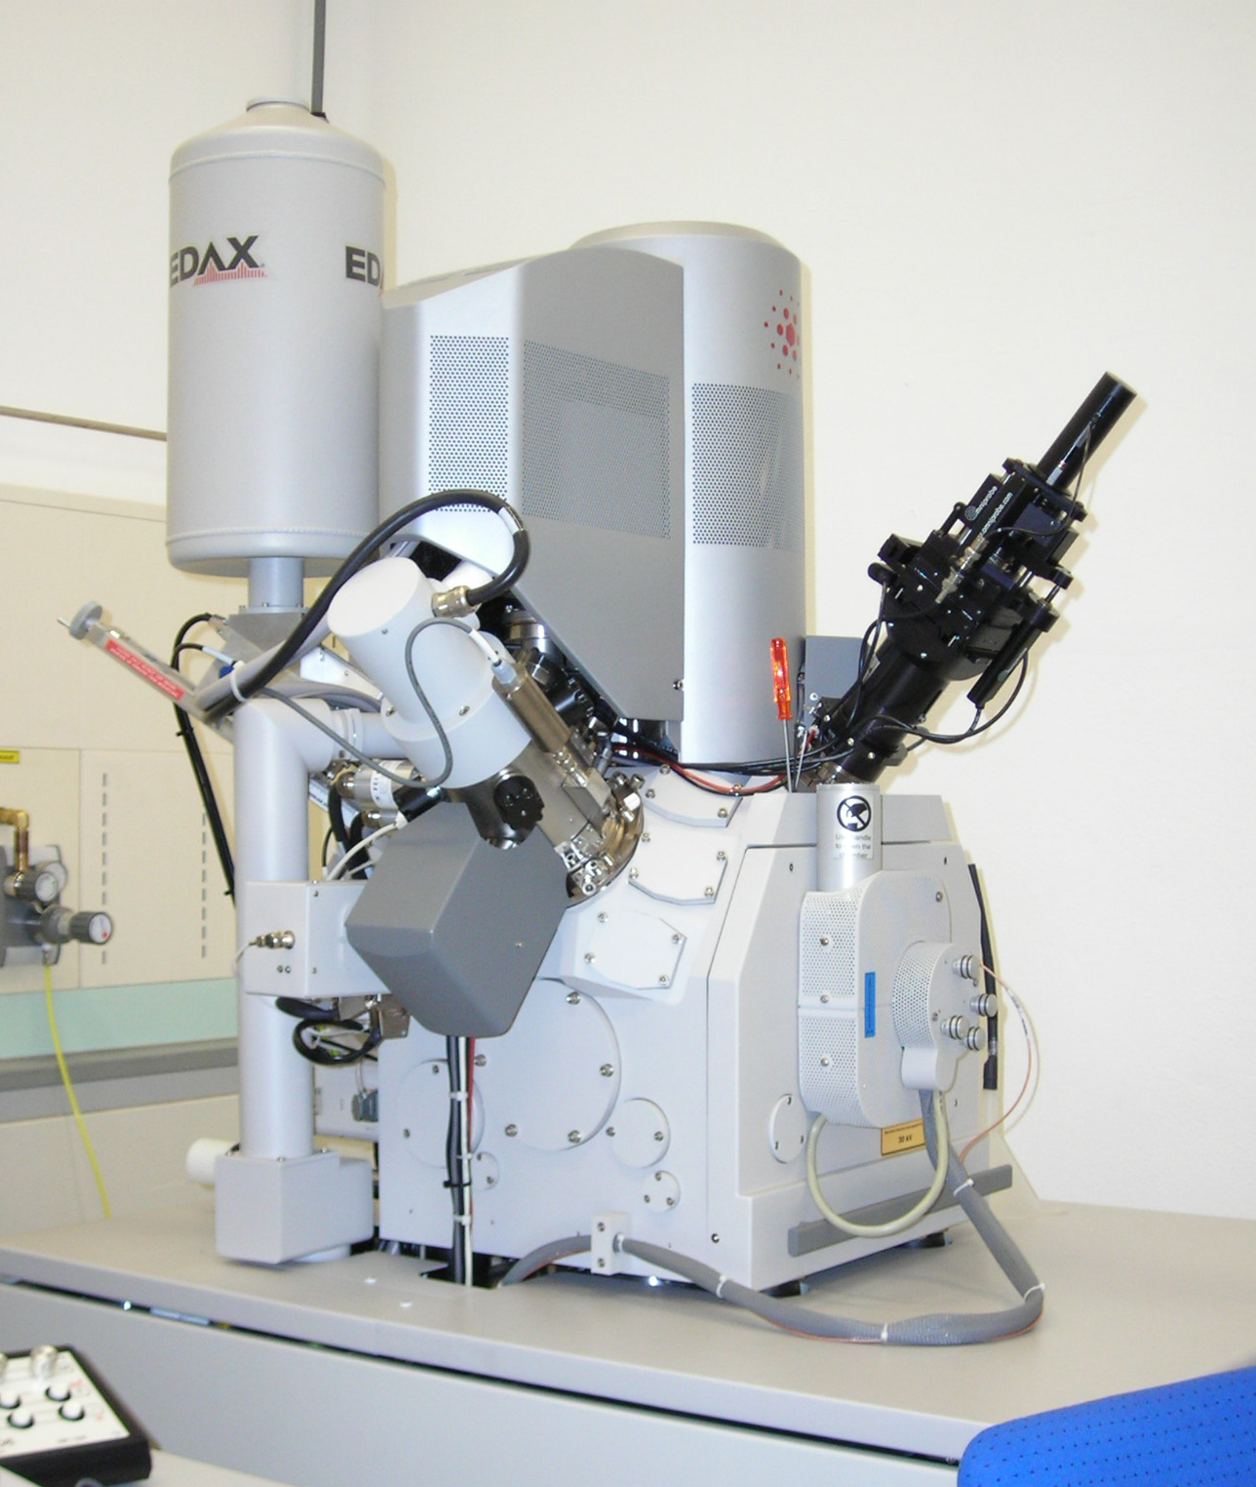
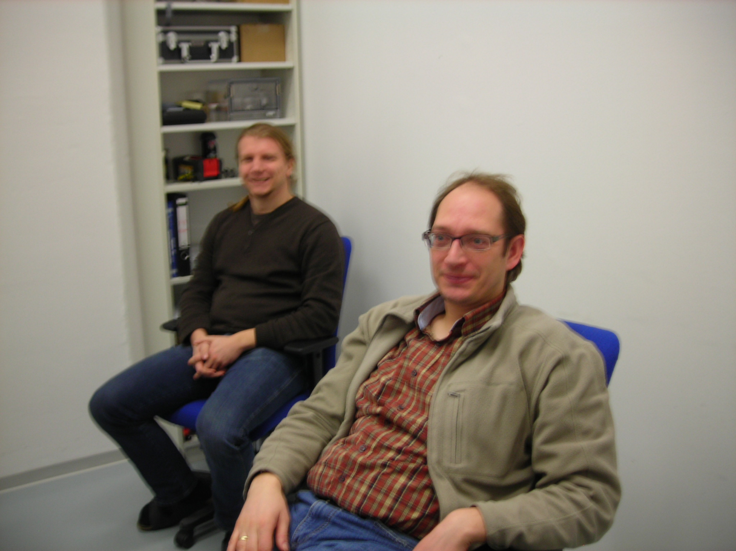
FIB at Jena
Sectioned and recovered two high pressure samples last week, began one more

Slide 12
Initial view of the sample
Milling a trench on first side
sample chamber
gasket indented from diamonds
sample chamber
gasket
trench
unindented gasket

Slide 13
Beginning to expose the LH spot
Deposited Pt and polished
sample chamber
sample chamber
LH spot
platinum
trench
LH spot
gasket
trench
gasket

Slide 14
Milling a trench on the other side
Thin sample from both sides to expose center of LH spot
trench
platinum
platinum
LH spot
trench
sample chamber
LH spot
gasket

Slide 15
Milled out sides, attached to needle, and lifted out
Fixed to a TEM grid and removed needle
needle
platinum
Pt source
LH spot
section of sample
platinum
platinum
gasket
TEM grid

Slide 16
Thinned to ~100 nm
View from above
platinum
platinum
platinum
LH spot

Slide 17
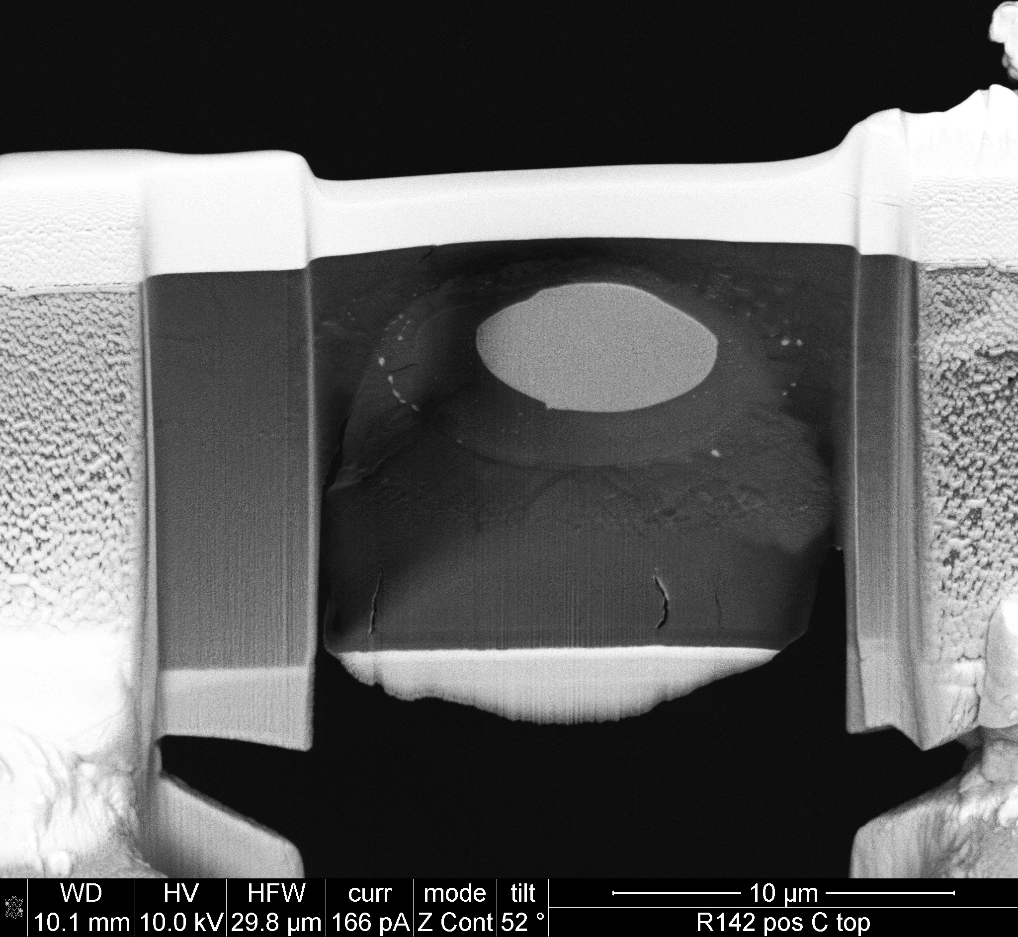
39 GPa, 3690 K
57 GPa, 4360 K
platinum
platinum
metal blob
metal blob
fp
silicate melt
platinum
platinum
silicate melt
fp
platinum
fp + pv
fp + pv

Slide 18
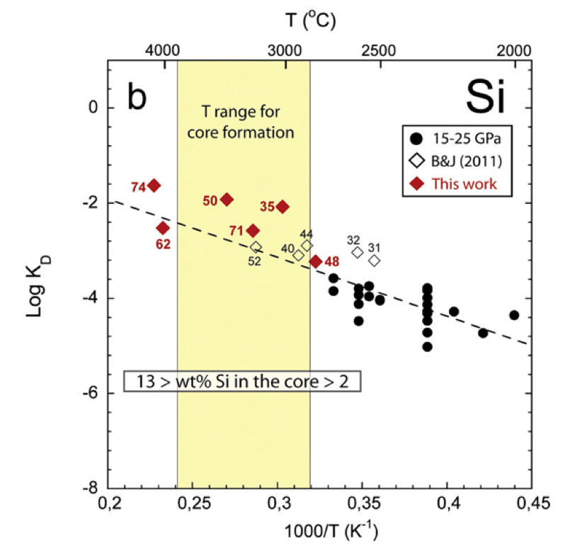
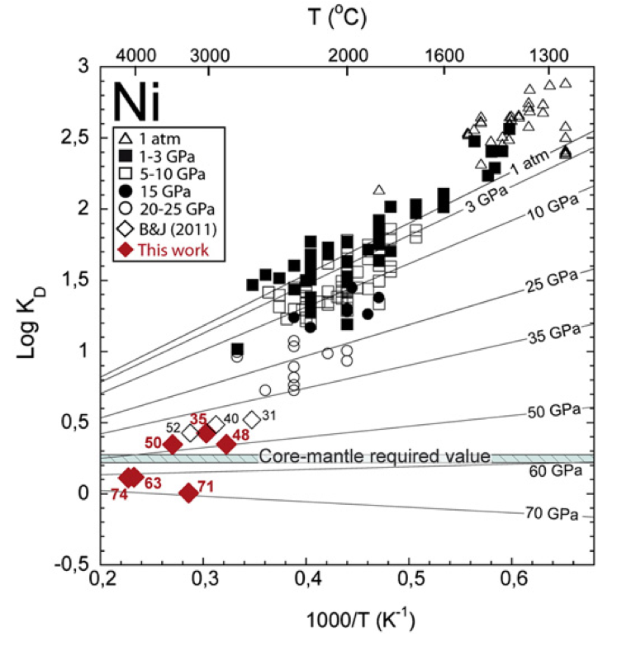
Exchange coefficients
Comparison to results from Siebert et al. (EPSL, 2012)
39
57
57
39
39
57

Slide 19
Conclusions: Progress so far
Seven high P-T experiments run
Two samples sectioned and recovered by FIB
TEM analysis on these two samples
K_{D} values for Co, Ni, Si
Acknowledgements:
Dave Rubie, Dan Frost, Catherine McCammon, Antje Vogel, Nobuyoshi Miyakima (BGI)
Kilian Pollok, Dennis Harries, Falko Langenhorst (Jena)
Andy Campbell, Dan Reaman, Dion Heinz, Hannah Mark, Bethany Chidester, Ian Steele, Gregory Myers (Chicago)
Vitali Prakapenka, Przemyslaw Dera (APS)
ERC, NSF, NSF-GRFP, ISGC

