Slide 1
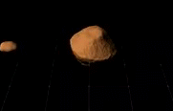
Rubble Pile Asteroid Evolution
Jan 30th, 2013
Seth A. Jacobson
BGI and OCA
1999 KW₄ [Ostro et al. 2004]

Slide 2
Evolutionary Flowchart
Observed systems
Evolution is cyclic
Final single states are the same as at the start

Slide 3
Radiative Torques
System
Barycenter
Body
Mass
Center
  Photons transfer momentum
  Change in momentum imparts a torque
  If lever arm is from the surface to the body center of mass then its YORP effect
  If lever arm is from the surface to the system barycenter then it’s the BYORP effect
    Added spin-orbit resonance requirement for BYORP effect
[Rubincam 2000, Scheeres 2007]
[Cuk and Burns 2007, McMahon & Scheeres 2010]

Slide 4
Tidal torques
Each body is deformed by the gravitational field of the other—changing fields lead to dissipation of energy
Torques transfer angular momentum between spin and orbit
Secondary
Primary

Slide 5
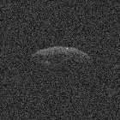
Observational Record
Photometric lightcurves
    Resolve asynchronicity
    Mutual event timing
    Long baseline
    Relative sizes
Radar Imaging
    Absolute sizes
    Complete shapes
    High sensitivity
    Detect synchronicity
KPNO 2.1-m
[Seth Jacobson]
2004 DC
Arecibo 305-m
[Patrick Taylor]

Slide 6
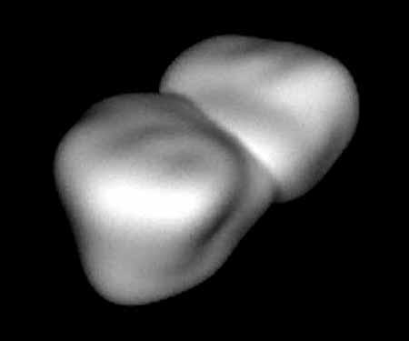
Near-Earth Asteroid Survey [Taylor et al. 2012]
84% are single asteroids
of which:
    56% are spheroids
    19% are elongated
    8% are irregulars
    17% are contact binaries
16% are multiple member
systems of which:
    15% are binary
    1% are ternary
Contact Binary
4769 Castalia

Slide 7
Small Binary Asteroid Populations
  4 distinct morphologies:
  Doubly synchronous
  Synchronous
  Tight asynchronous
  Wide asynchronous
Pravec Binary Database
Pravec et al. (2006, 2007)

Slide 8
Small Binary Asteroid Populations
  4 distinct morphologies:
  Doubly synchronous
  Synchronous
  Tight asynchronous
  Wide asynchronous
Pravec Binary Database
Pravec et al. (2006, 2007)

Slide 9
Small Binary Asteroid Populations
  4 distinct morphologies:
  Doubly synchronous
  Synchronous
  Tight asynchronous
  Wide asynchronous
Pravec Binary Database
Pravec et al. (2006, 2007)

Slide 10
Binary Formation Hypotheses
By capture
  Rare close flybys at low relative velocities
  Preferentially creates wide binaries
From impact ejecta
  Rare conditions create long lasting binaries
  Does not preferentially create rapid primary rotation
By rotational fission
  Explains rapid primary rotation
  Requires ``rubble-pile’’ interior model

Slide 11
Evidence for Rotational Fission
Single asteroids obey spin limit
Defines highest rotation rate a gravitationally bound object can withstand
Minor Planet Lightcurve Database, [Brian Warner 2012]

Slide 12
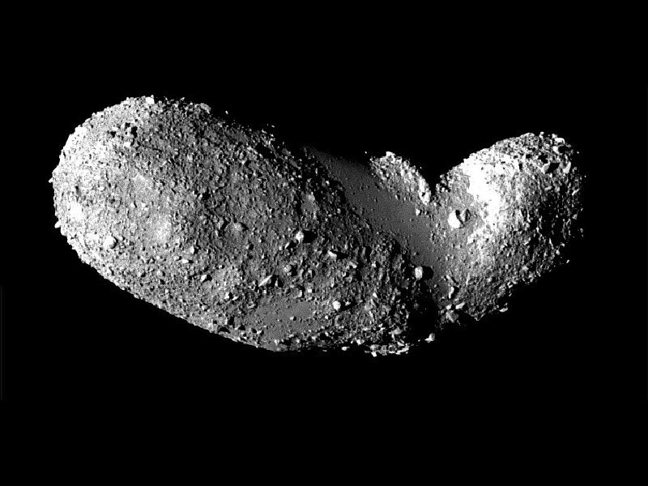
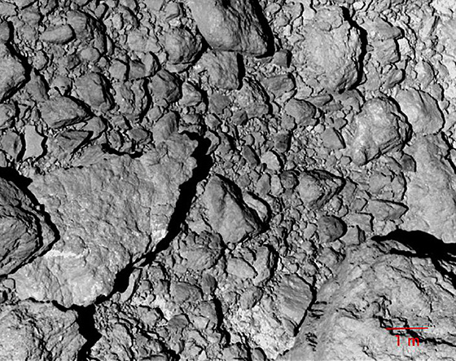
Evidence for ``Rubble-pile’’ interior
Itokawa
Regolith not consistent with impact process
-- too large
Hayabusa JAXA

Slide 13
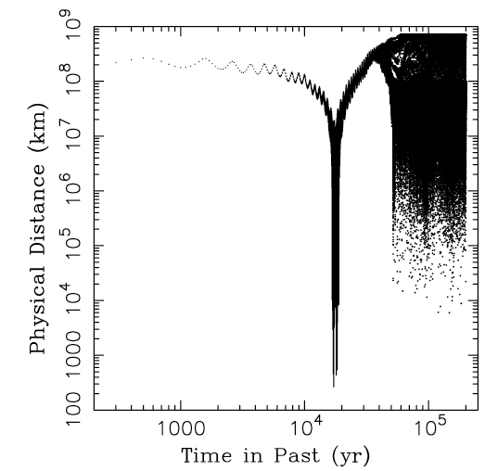
Small Binary Asteroid Populations
Asteroid Pairs
  Similar heliocentric orbits
  Backward integration reveals close encounters in phase space
Vokrouhlicky & Nesvorny 2008

Slide 14
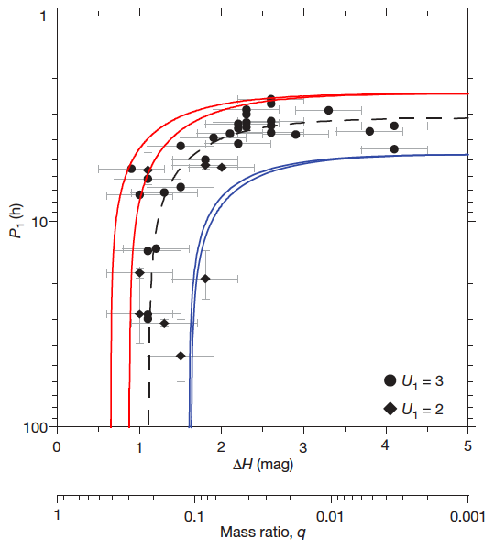
Asteroid Pair Evidence for Rotational Fission
[Scheeres 2007]
[Pravec et al 2010]

Slide 15
Rotational fission of ``rubble-pile’’ asteroids
Clear evidence for rotational fission of rubble pile asteroids
Can this process lead to the observed binary asteroids?
What happens after rotational fission?
  Our method: Determine dominant process at each step and then evolve the system

Slide 16
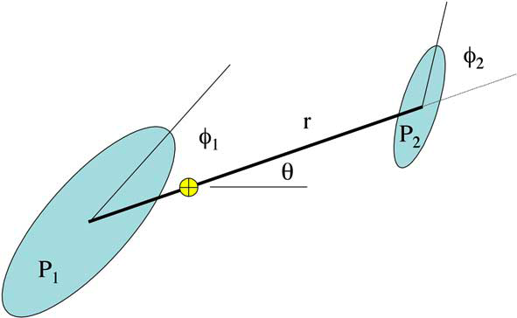
Numerical Models
Short-term evolution
2nd order gravity to capture spin-orbit coupling (assuming planar motion)
Secondary fission
Solar gravitational perturbations
Mutual body tides
Long-term evolution
Mutual body tides
YORP effect
BYORP effect

Slide 17
Evolutionary Flowchart

Slide 18
Importance of mass ratio
Mass Ratio Dictates Evolutionary Track of System
Zero Free Energy for Two Spheres

Slide 19
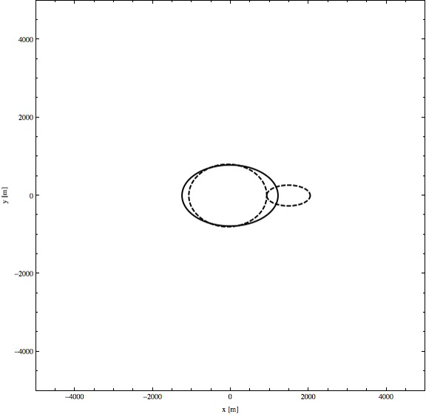
Low Mass Ratio Binaries
Unbound (positive free energy)
Transfers of energy and angular momentum
Secondary fission

Slide 20
Binary YORP Evolution
B is the averaged acceleration in the direction parallel
to the motion of the secondary
Semi-major axis can expand or contract
Semi-major axis and eccentricity have opposite signs
McMahon & Scheeres (2010)

Slide 21
Tidal Evolution
Geophysical Parameters
  Tidal Love number: k
  Tidal dissipation: Q
Semi-major axis always expands
Eccentricity can either damp or grow depending on the tidal Love number
Goldreich & Sari (2009)

Slide 22
Just Tides – Period of the secondary
No YORP
BYORP acceleration
Tidal synchronization
BYORP and tidal equilibrium

Slide 23
YORP deceleration – Period of the secondary
No YORP
Faster Synchronization
YORP decelerating

Slide 24
YORP acceleration – Period of the secondary
Delayed Synchronization
No YORP
YORP decelerating
YORP accelerating
Balanced,
long lasting
Eventual fission
of the secondary

Slide 25
Joint Opposing Evolution
All systems evolve in semi-major axis to a stable equilibrium
Tides still dominate eccentricity evolution, so e damps

Slide 26
BYORP and Tidal Equilibrium
Data from Pravec et al catalogue

Slide 27
Evolutionary Flowchart

Slide 28
Test the Binary Asteroid Evolution Model
We can create each of the observed binary morphologies and other asteroid systems
Can we match their relative proportions?
Two Free Parameters
  Initial mass ratio
  fraction
  Binary lifetime
  Otherwise very
  constrained model
Typical Log₁₀ Lifetime [yrs]

Slide 29
Monte Carlo Model
Evolve 2×10⁶ bodies for 4.5×10⁹ years
Initial size, shape, and spin drawn from distributions from observation [Bottke et al. 2005, Giblin et al 1998, Donnison & Wiper 1999]
YORP effect [Scheeres 2007]
Collisions [Farinella & Davis 1992, Bottke et al. 1994, Statler 2009]
  Catastrophic
  Sub-catastrophic
Rotational Fission
  Spin limits
  Implement asteroid
  evolution model

Slide 30
Comparison to observation
Steady-State Binary Fraction: 0.16 ± 0.07
Fast Binary Fraction: 0.66 ± 0.12

Slide 31
Comparison to observation
Contact Binary Fraction: 0.15 ± 0.07
Steady-state Mass Ratio Fraction: 0.2 ± 0.1

Slide 32
Best Fit Parameters
Consistent with McMahon & Scheeres 2010
Consistent with an initial flat mass ratio distribution

Slide 33
Results from the asteroid population model
Typical binary lifetimes are less than 10⁶ years
Initial mass ratio fraction consistent with rotational fission along internal planes
Contact binary formation is not 100% efficient
2% of the Main Belt may be observable as asteroid pairs
Population proportions are strongly size dependent

