Slide 1
The effect of sulfur on metal-silicate partitioning of the HSE during core formation
Vera Laurenz
David C. Rubie, Daniel J. Frost, Andreas Audétat

Slide 2
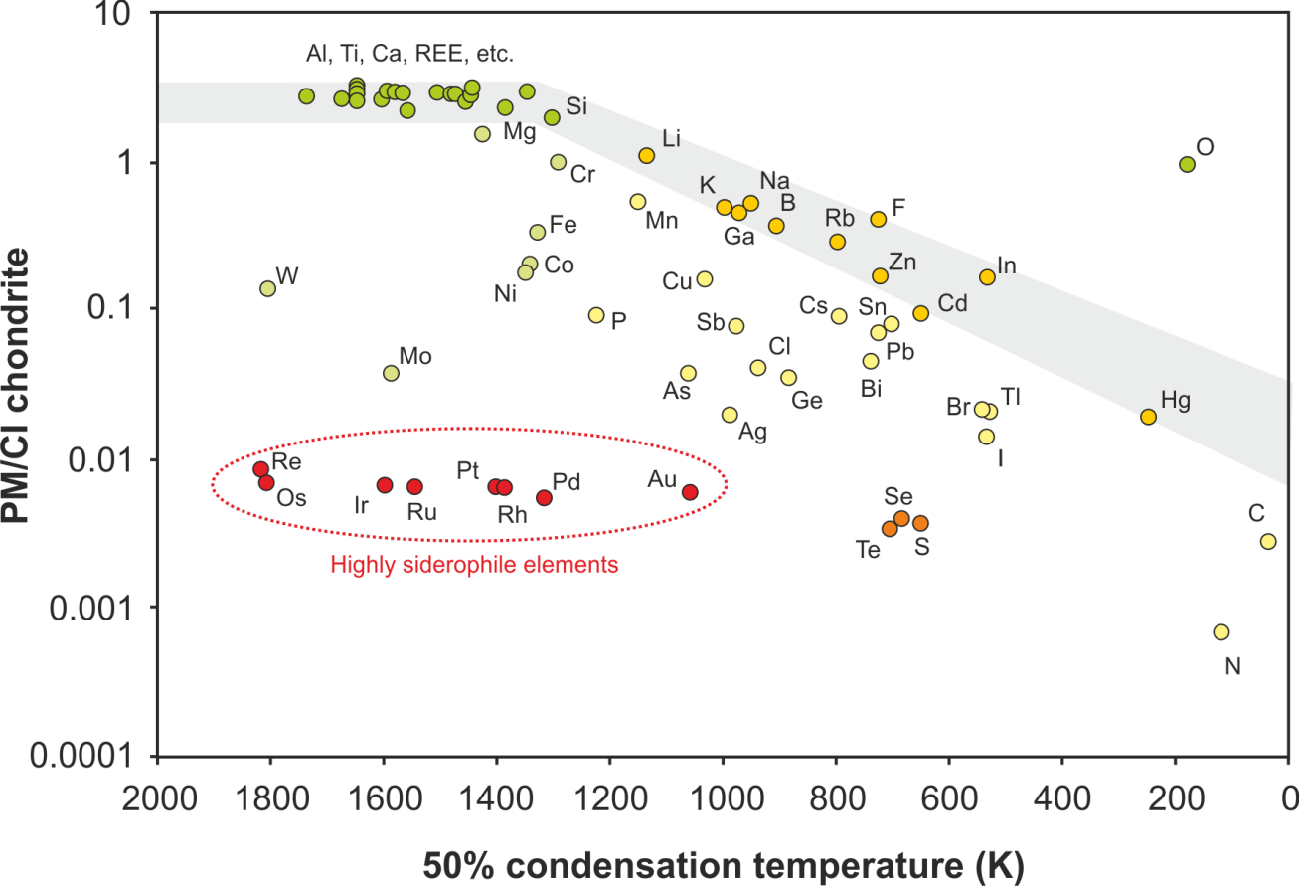
Volatility trend
Data sources:
Lodders et al. (2003); Palme and O‘Neill (2003)

Slide 3
Comparison with chondrites
Becker et al. 2006, GCA
PUM not reproduced by known meteorite groups

Slide 4
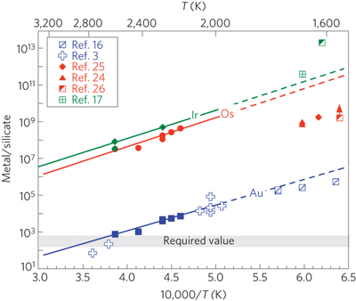
Metal silicate partitioning at high T
2 GPa, ΔIW+2
Brenan and McDonough. 2009, Nature Geoscience
Au strongly fractionated from Ir and Os
→ Late veneer required to explain observed mantle abundances

Slide 5
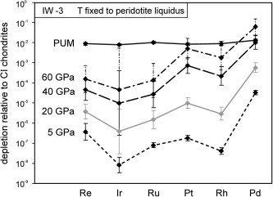
Metal silicate partitioning at high P
Mann et al. 2012, GCA
HSE fractionated from each other at high pressures
→ Late veneer required to explain observed mantle abundances

Slide 6
Effect of S on metal–silicate partitioning?
Experiments with S-bearing metal plot below S-free experiments
Pd less siderophile

Slide 7
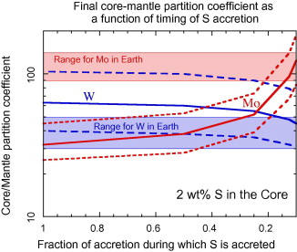
S during Earth‘s accretion
Hadean matte (O‘Neill 1991)
Mo and W abundances reproduced if S is added during last 10% of core formation (Wade et al. 2012)
Wade et al. 2012, GCA

Slide 8
HSE in the Earth‘s mantle
Becker et al. 2006, GCA
Ru and Pd suprachondritic
Most chalcophile of the HSE
Do the suprachondritic Pd and Ru result from S effect
on metal silicate partitioning?

Slide 9
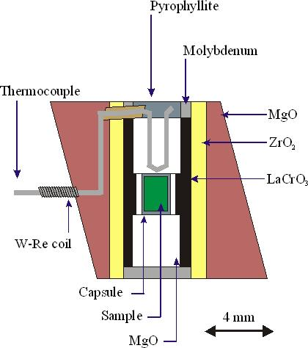
Multianvil experiments
Silicate: primitive mantle composition (Palme and O‘Neill, 2003)
Fe-rich metal
10 wt. % Pt T = 2200-2500 °C
10 wt. % Pd or Ru P = 6-18 GPa
5-10 wt. % S
Courtesy of D. Frost

Slide 10
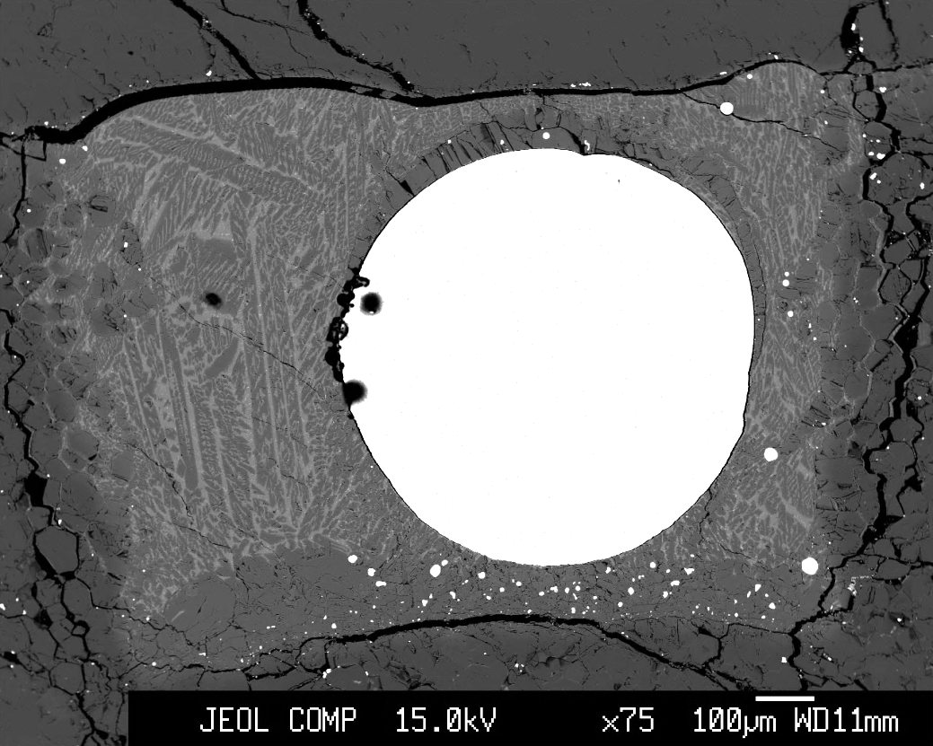
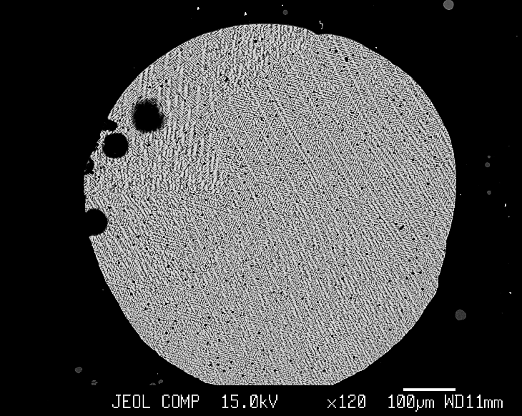
BSE Images
MgO
11 GPa, 2200°C
Fe-Pd-Pt-S metal
fp
quenched
silicate

Slide 11
First results
5 wt. % S in metal
$$K_{D}=\frac{D_{HSE}^{metal−silicate}}{{\left(D_{Fe}^{metal−silicate}\right)}^{\frac{n}{2}}}$$

Slide 12
Outlook
Experiments
→ S-content of the metal
→ Temperature
→ Pressure
Correct partition coefficients to infinite dilution of HSE in the metal phase
Can the observed PUM signature be reproduced by core-formation followed by a late veneer?

Slide 13
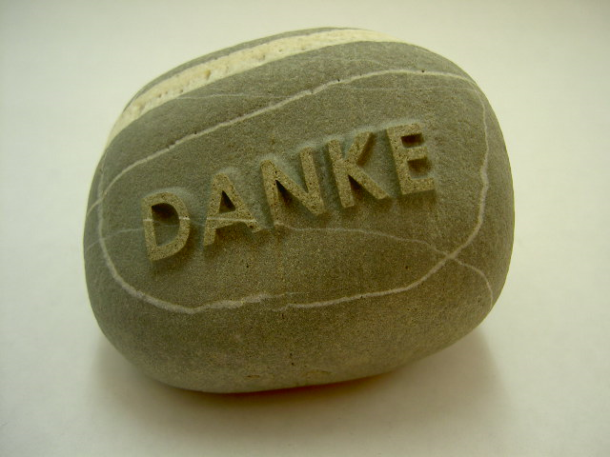
Danke!

